Slide 1
District 57 Pathways Launch Preview TLI Jan 7, 2017 George Marshall D57 Chief Pathways Guide gdmarshall@gmail.com

Slide 2
Revitalized Education Program, now: Pathways
Five Years in Development
Arrives in D57 on Feb 7
First District on Pathways: We Are The Leaders!

Slide 3
What IS Pathways ?
Re-invention of our program
Communication & Leadership: Integrated
Built on tried and true materials

Slide 4
Benefits of Pathways
Tailored, self-paced learning
Flexibility to choose experience
Greater access to materials
Expanded resources
Real-world applicability

Slide 5
What’s New?
New Manuals, New Projects
Improved Mentoring Program
Faster Recognition
More Choices for You
More Tutorials and Online Training

Slide 6
What Stays the Same?
Club Meetings: Speeches, Table Topics, Evaluations
Club Officers
District Officers
Club Sponsor/Mentor/Coach

Slide 7
How Does it Work?
Ten Possible Paths
Replaces all current manuals
Each Path: Five Levels
Mix of Comm and Leadership projects
Required and Elective Projects
DTM requires two Paths
Plus more

Slide 8
The Ten Paths
Motivational Strategies
Presentation Mastery
Leadership Development
Innovative Planning
Visionary Communication
Strategic Relationships
Dynamic Leadership
Persuasive Influence
Effective Coaching
Team Collaboration

Slide 9
How Do We Use Pathways?
Base Camp!

Slide 10
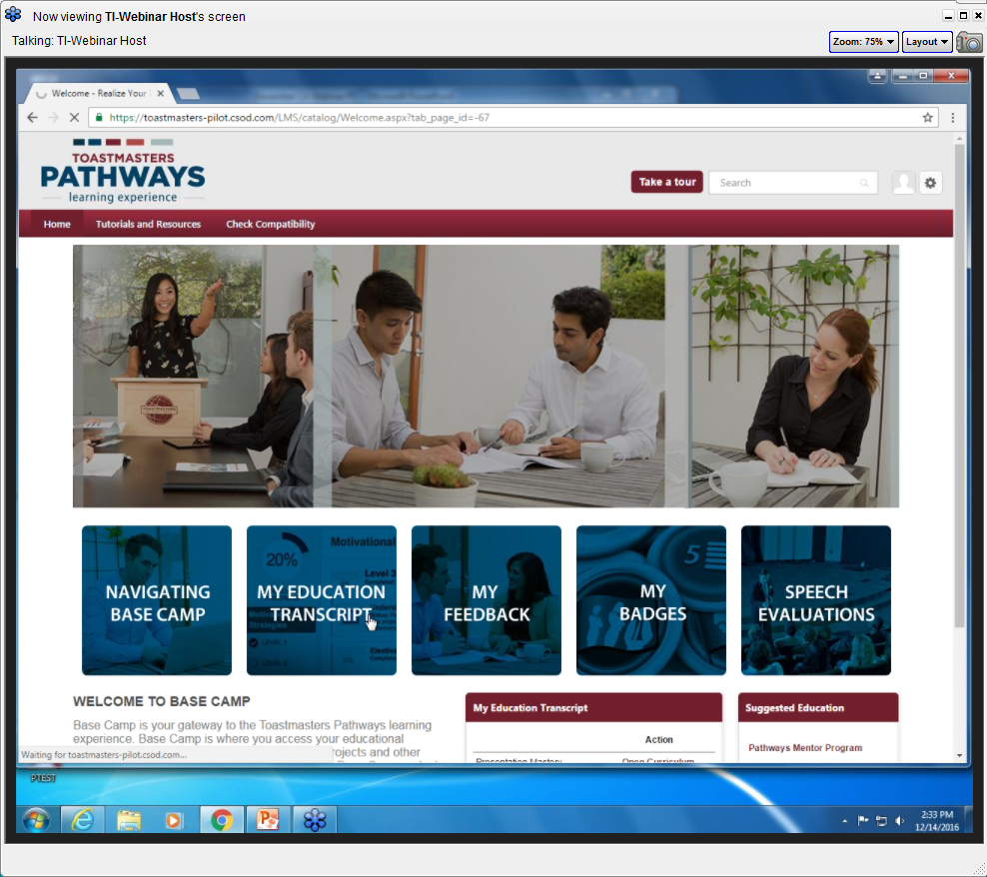
Base Camp – Center of Everything

Slide 11
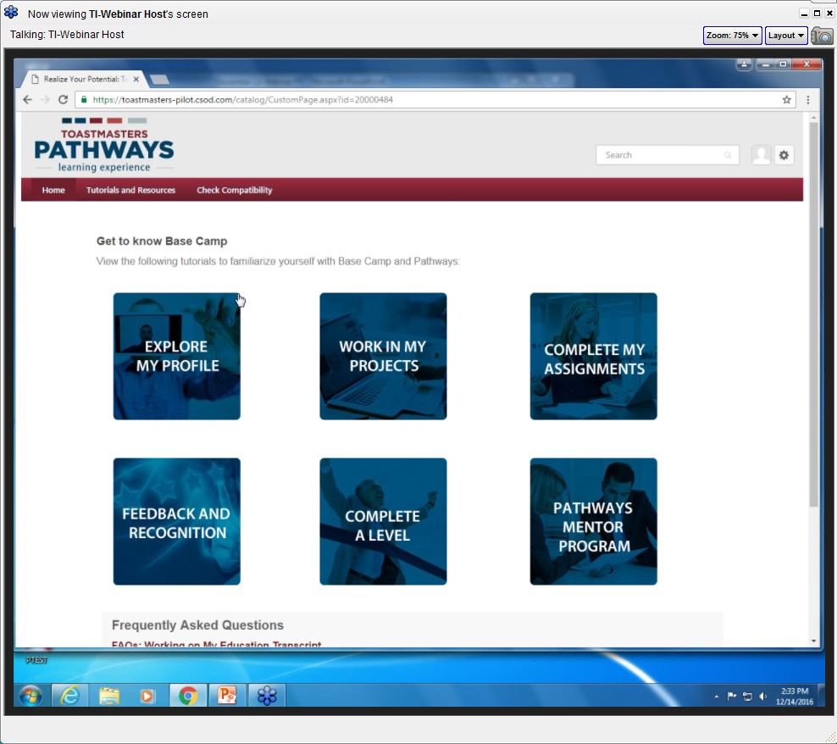
Lots of Tutorials Available!

Slide 12
Transition Plan

Slide 13
Transition from Now to New
Existing Members, during transition can:
Stay on current plan
Switch to Pathways
Work on both simultaneously
New Members, after launch:
Pathways only, no choice
Club Officers Need to Know Pathways
Even if you stay on current program!

Slide 14
Current Program will Sunset in about Three Years from Jan 2016
After Sunset: No more current awards can be filed
You keep all awards
Start Planning that DTM Now

Slide 15
DCP During Transition: Current and New Awards Counted Only Educational DCP Goals Affected
Goal
1
2
3
4
5
6
Select current or new award for each goal
OR
For each of the six goals, either current or
new program awards can be used to earn it

Slide 16
How Are We Going to Get Started? With Help!

Slide 17
Pathways Guides
Local support for clubs
Every D57 club is assigned a Guide
Visit www.d57tm.org/pathways for your guide
Guide visits club for quick start
Brings Rollout kit
Gives “Getting Started” Presentation
Guide supports club for several months
You need your guide to visit ASAP!

Slide 18
Questions about Pathways in D57?
See if it has already been answered at: d57tm.org/pathways
Send your question to: pathways@d57tm.org

