Slide 1
Pathways Fast Start
George Marshall
D57 Chief Pathways Guide
gdmarshall@gmail.com District 5 TLI 2/3/2018

Slide 2
Pathways Rollout Progress
R 4 & 13 Apr 18
D 27 Mar 17
D 57 Feb 17
R 8, 9 & U May 18
R 6 & 7 Oct 17
R 14 Jul 17
R 2 Sep 17
R 1 & 11 Mar 18
R 3 & 5 Feb 18
D 51 May 17
R 10 & 12 Dec 17

Slide 3
Compare Programs: Traditional to Pathways

Slide 4
Traditional Program Chart to DTM
Club Officer+
District Officer Sponsor/Mentor/Coach HPL
DTM
Speechcraft,
YLP, et al
Educ.

Slide 5
Pathways Chart to DTM
Club Officer-12 mo
District Officer
Club Mentor or Club Coach
Club Sponsor or Speechcraft or Youth Leadership Program
New Member
DTM PROJECT “Capstone”
DTM

Slide 6
The Hardest Part of Any New Project …
Getting Started!

Slide 7
Enter Pathways
Select a Path
Open Your First Project
Submit Awards

Slide 8
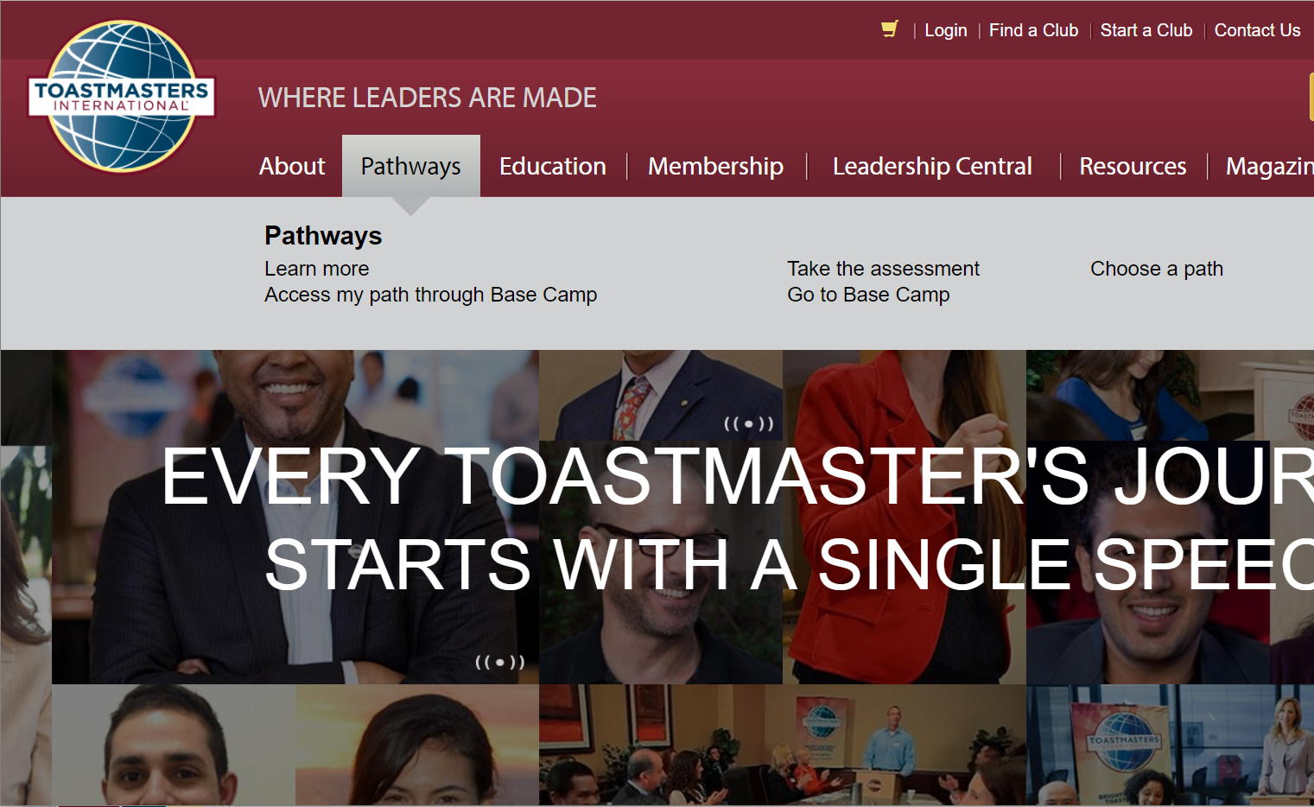

Slide 9
Login, or setup your account

Slide 10
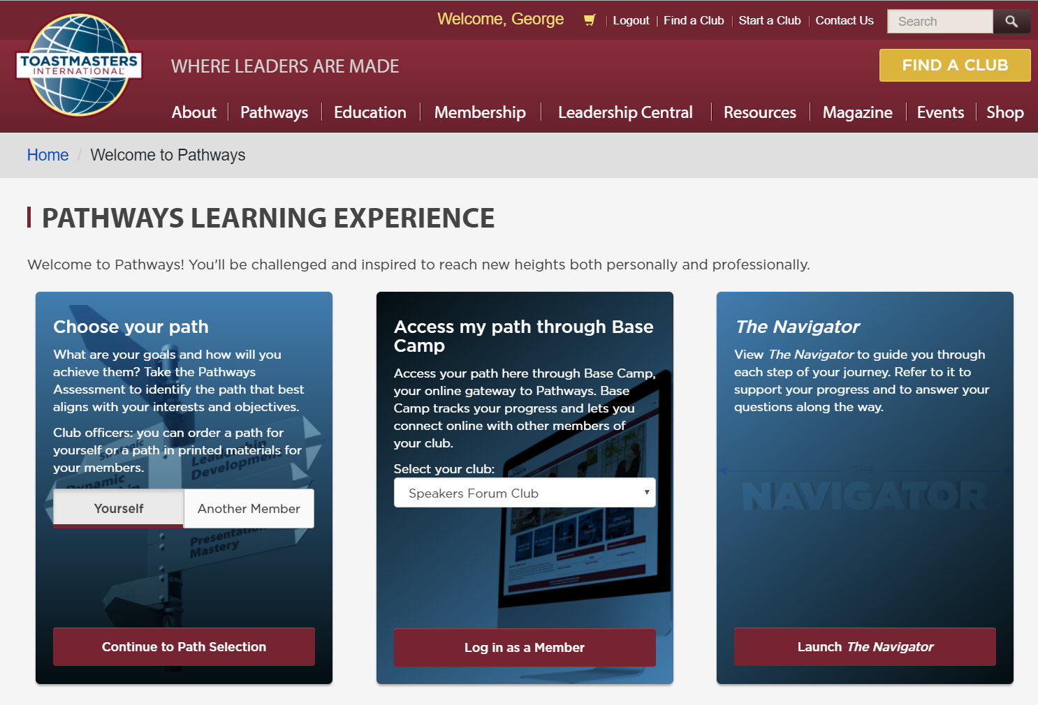

Slide 11
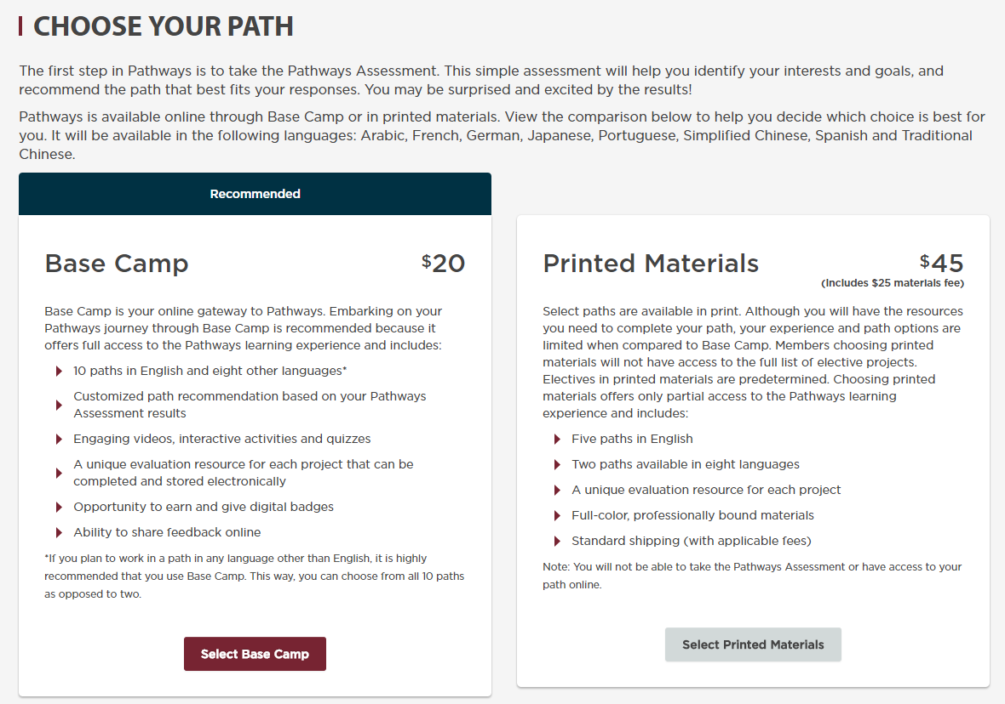
Free
$25
Select an Online Path
Select a Printed Path

Slide 12
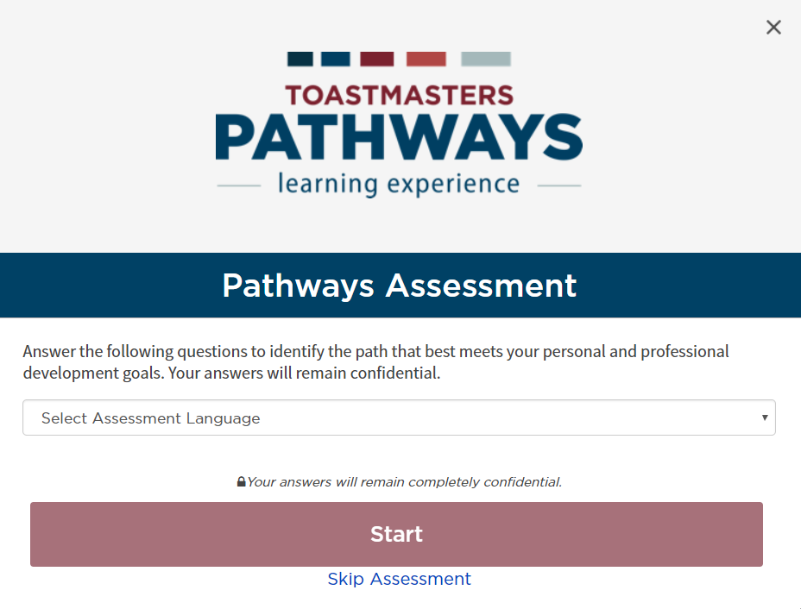

Slide 13
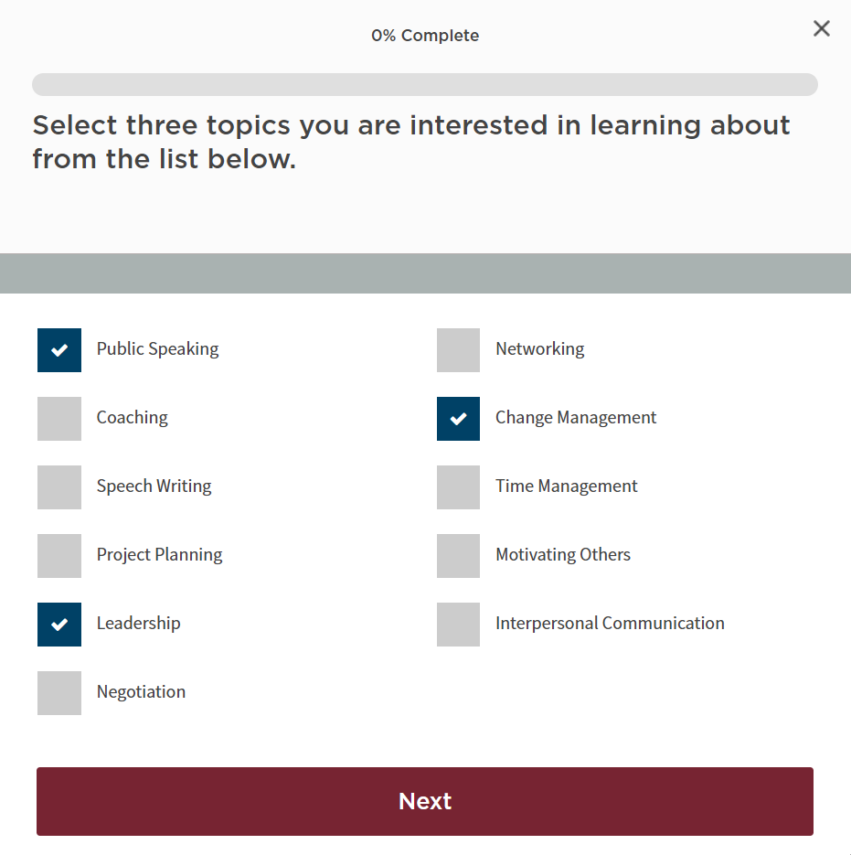

Slide 14
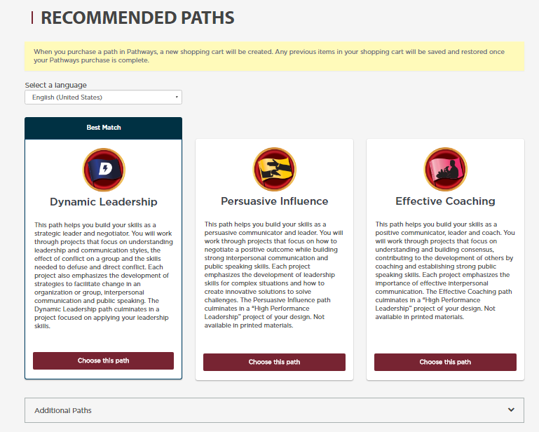

Slide 15
For More Details on Any Path
Pathways area on the D57 website:
www.d57tm.org/pathways/
Get the D57 catalog file (pdf):
“Pathways Path and Projects Catalog”
Very Useful Resource!

Slide 16
Enter Pathways Select a Path Open Your First Project

Slide 18
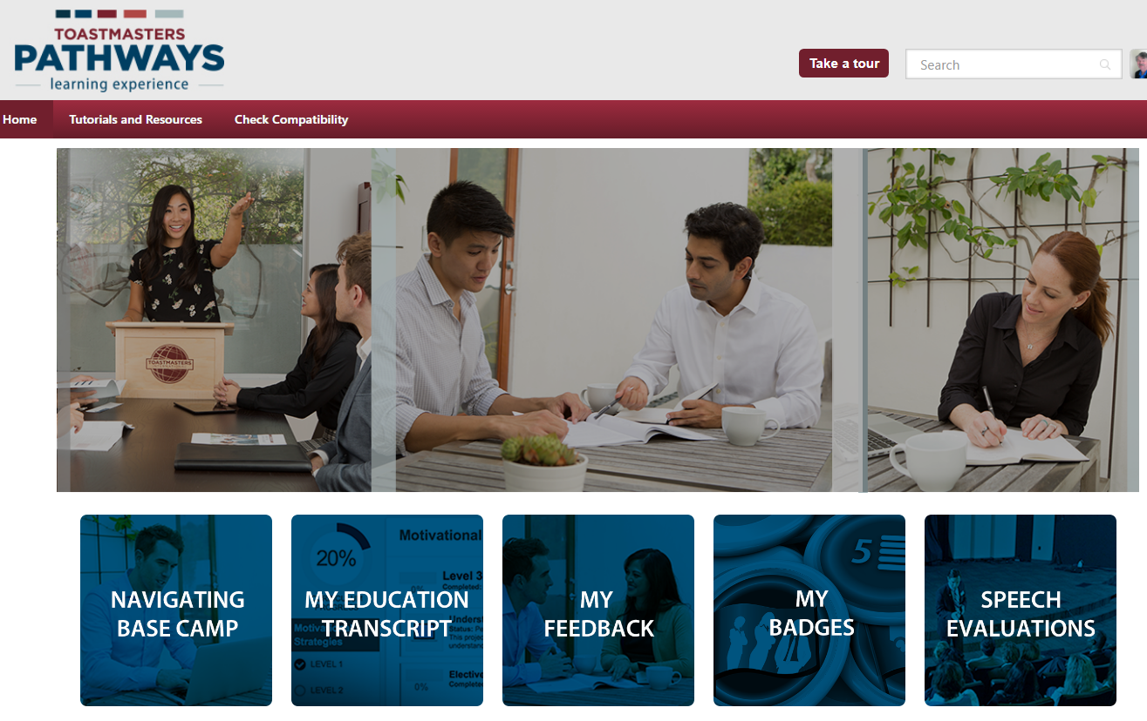

Slide 19
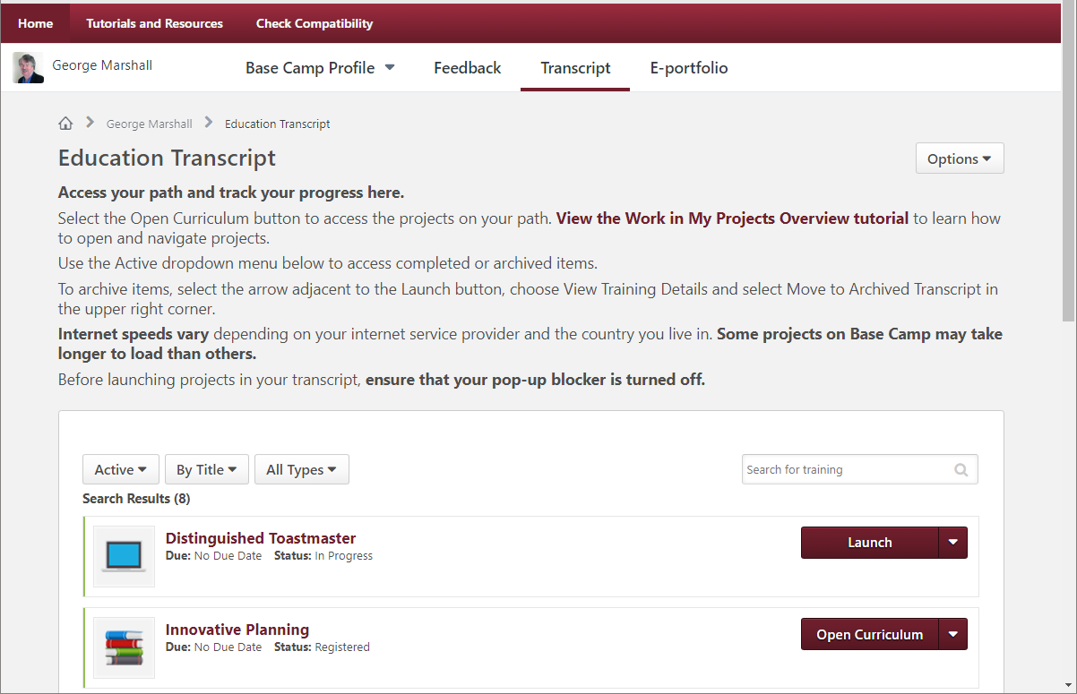

Slide 20
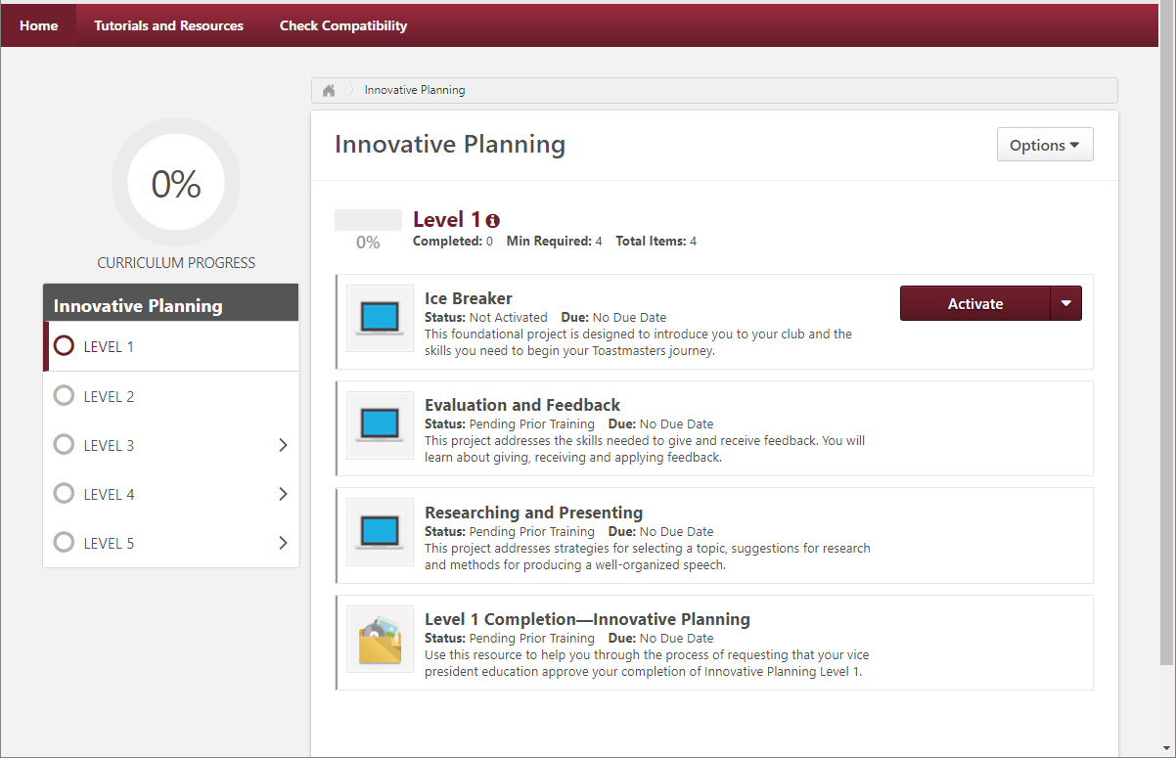

Slide 21
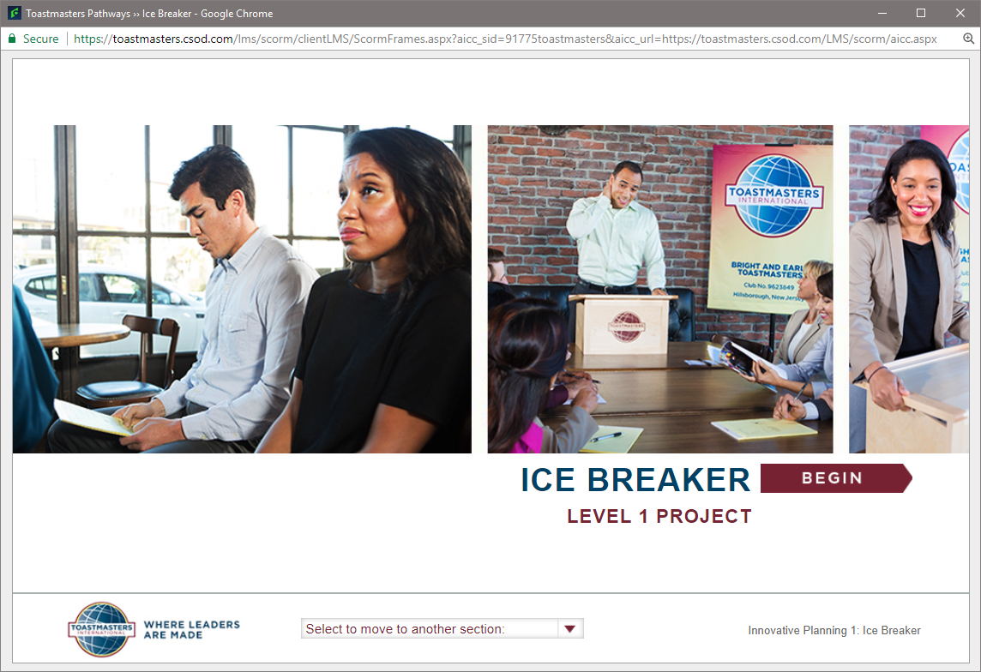

Slide 22
Enter Pathways
Select a Path
Open Your First Project
Submit Awards

Slide 23
Completing Projects, Levels and Awards Online Who Does What?
Member
Complete a project - give the speech
Then re-open project, complete Assess Skills-After

Slide 24
Reopen Project in Base Camp

Slide 25
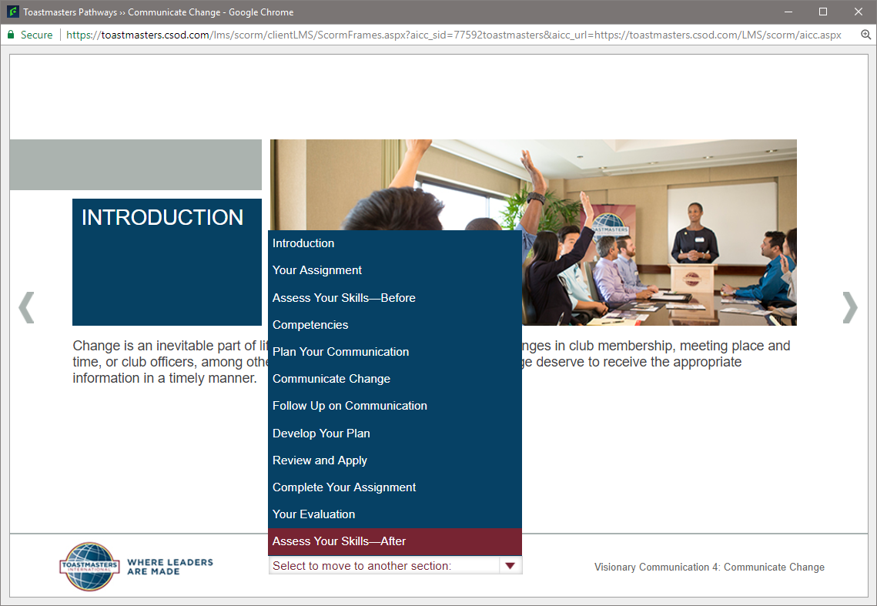

Slide 26
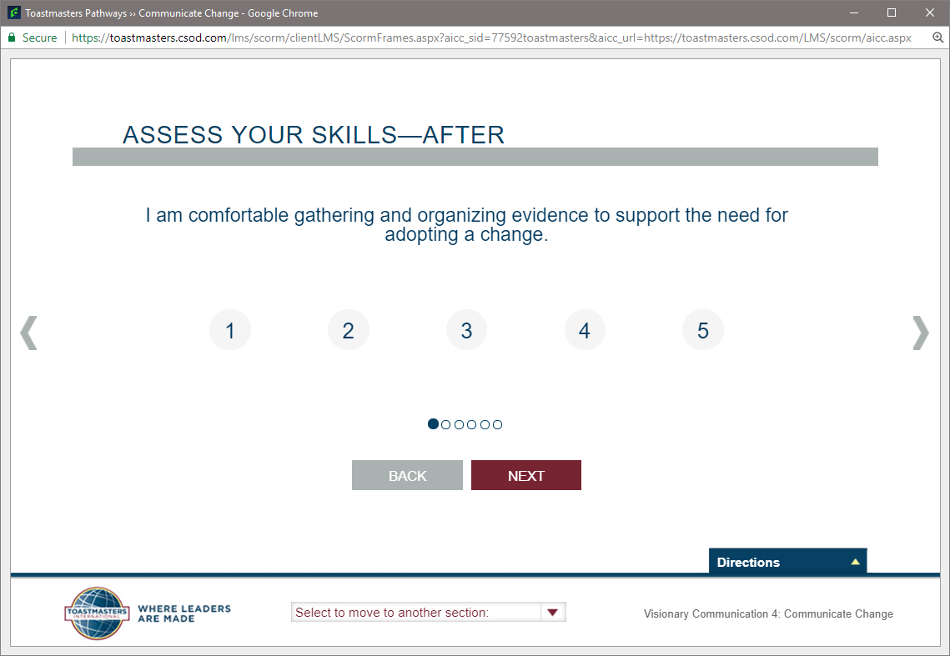

Slide 27
Completing Projects, Levels and Awards Online
Member
Complete a project
Re-open project, complete Assess Skills-After
No approval needed to continue
Complete a level
Run the “Level Completion” task in your path

Slide 28
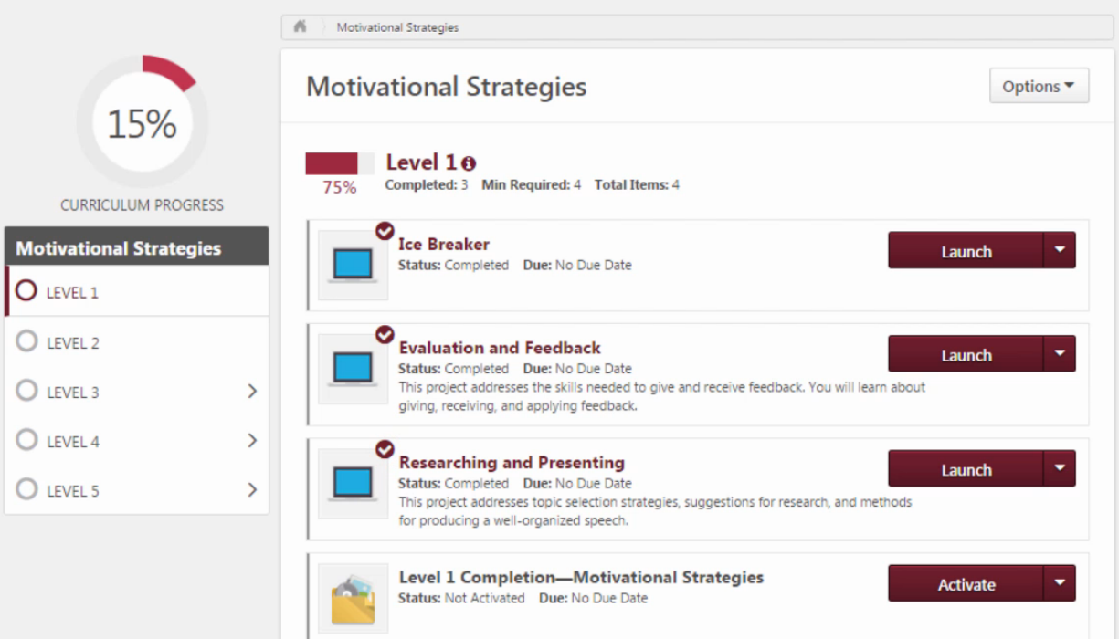

Slide 29
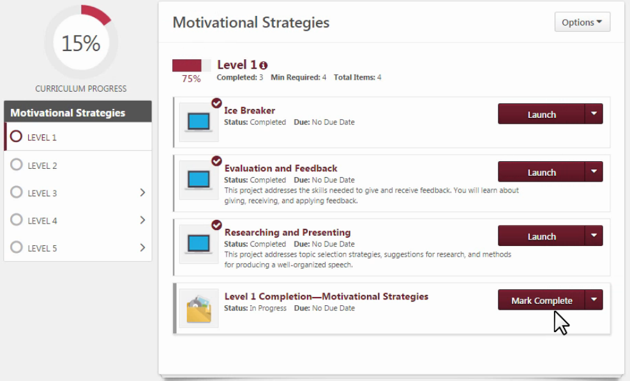

Slide 30
Completing Projects, Levels and Awards Online
Member
Complete a project
Re-open project, complete Assess Skills-After
Complete a level
Run the “Level Completion” task
Notify your VPE and base camp managers – Level completion must be approved to move on
Base Camp Manager (VPE, Pres or Sec)
Mark the member’s level as Approved

Slide 31
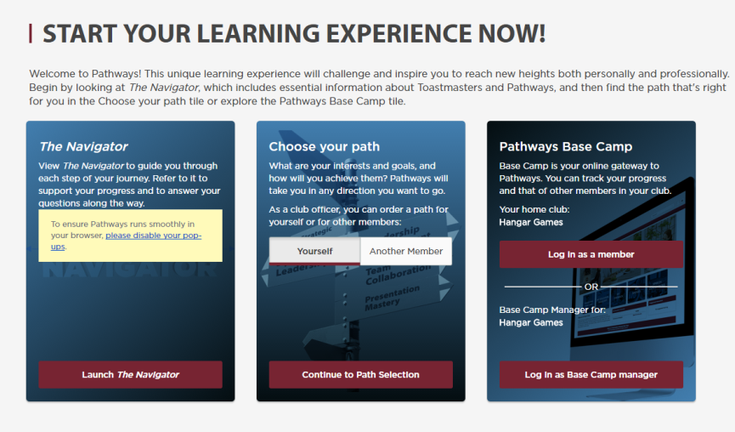
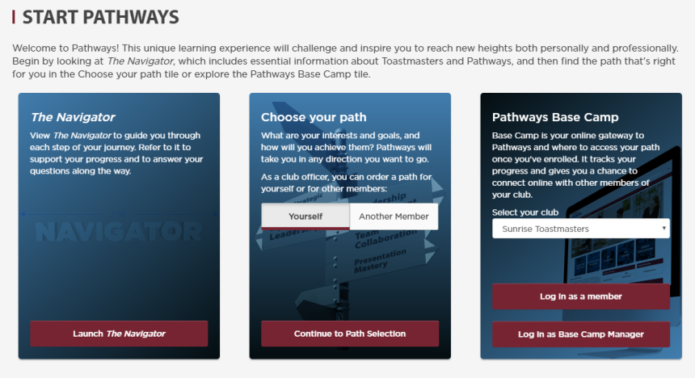

Slide 34
Completing Projects, Levels and Awards Online
Member
Complete a project
Re-open project, complete Assess Skills-After
Complete a level
Run the “Level Completion” task
Notify your VPE and base camp managers – Level completion must be approved to move on
Base Camp Manager (VPE, Pres or Sec)
Mark the member’s level as Approved
Member can now proceed to next level !
VPE (or Any Officer)
Approving a Level does NOT submit the award
Submit Level award in Club Central

Slide 35
Get Started on Pathways!
Why?
Understand the Program
Help New Members
Set a Great Example!

