Slide 1
Pathways Fast Start
George Marshall
D57 Chief Pathways Guide
gdmarshall@gmail.com D57 Fall Conference 11/4/2017

Slide 3
The Hardest Part of Any Project …
Getting Started!

Slide 4
Enter Pathways
Select a Path
Open Your First project

Slide 5
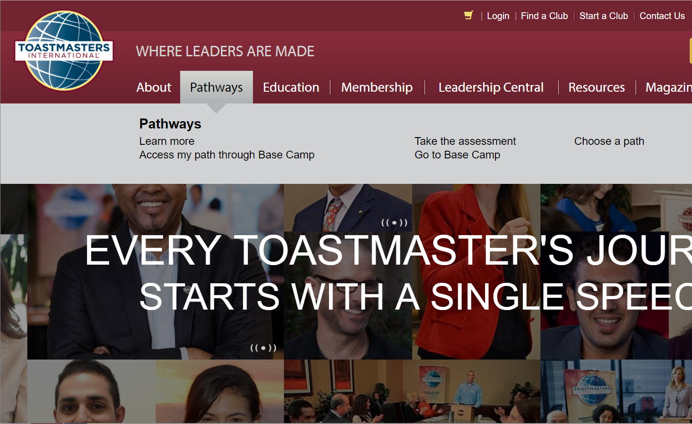

Slide 6
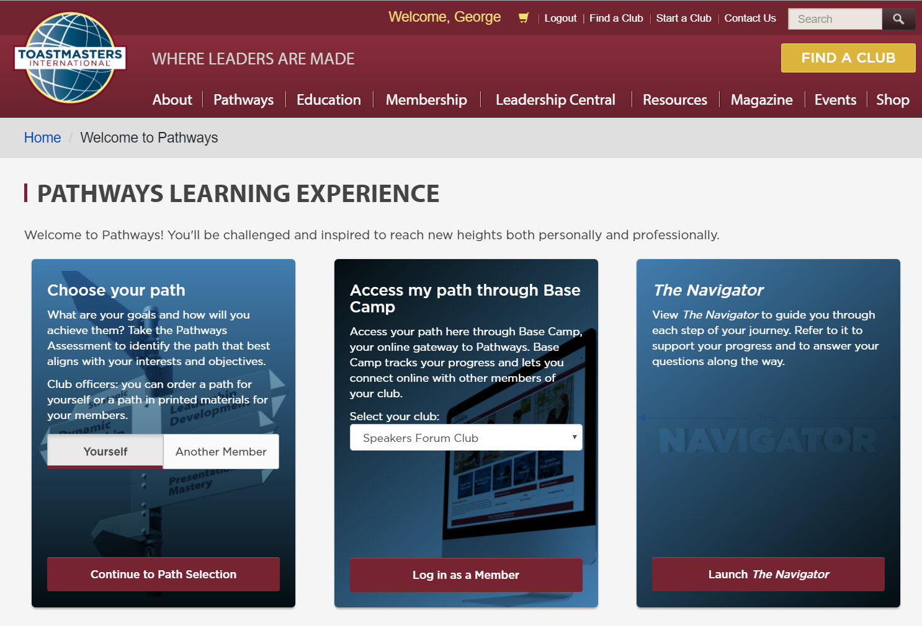

Slide 7
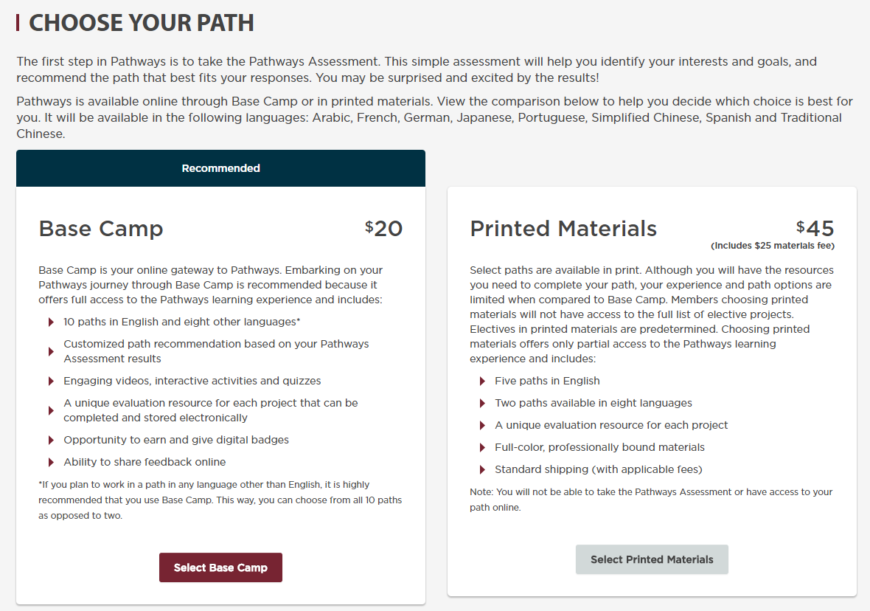
Free
$25
Select an Online Path
Select a Printed Path

Slide 8
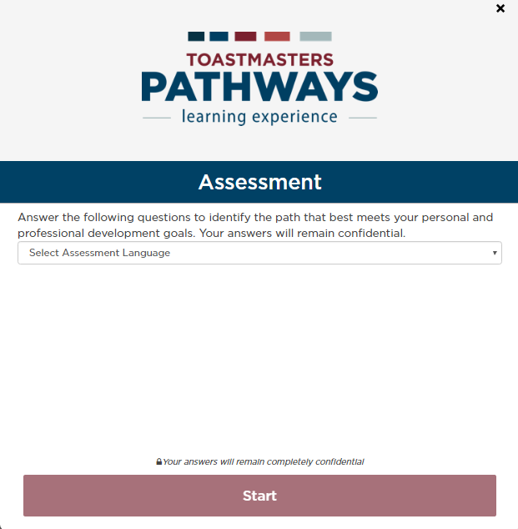

Slide 9
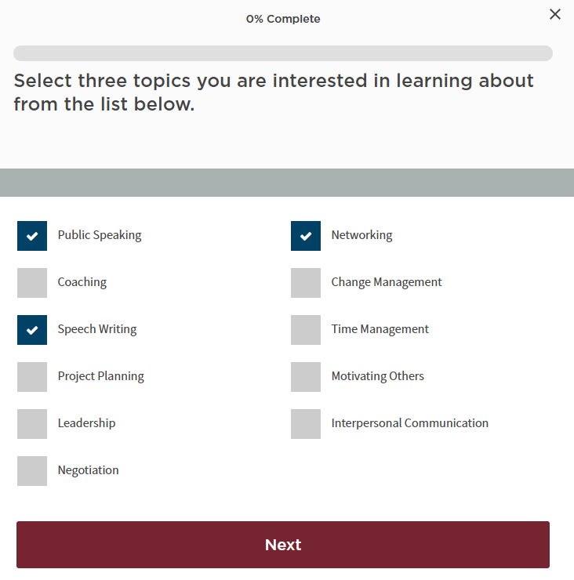

Slide 10
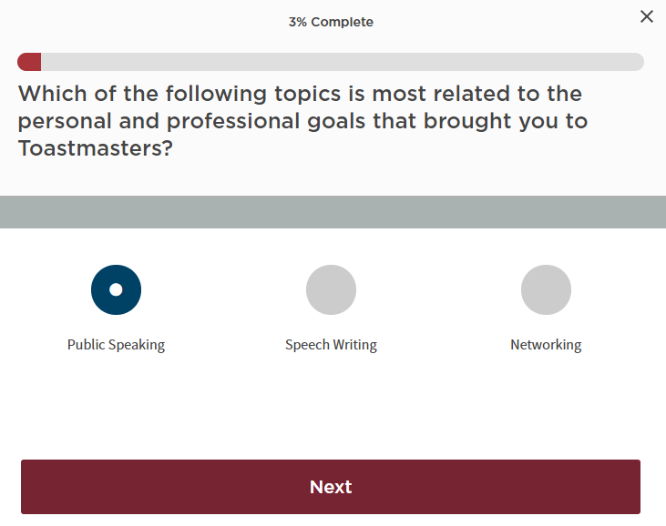

Slide 11
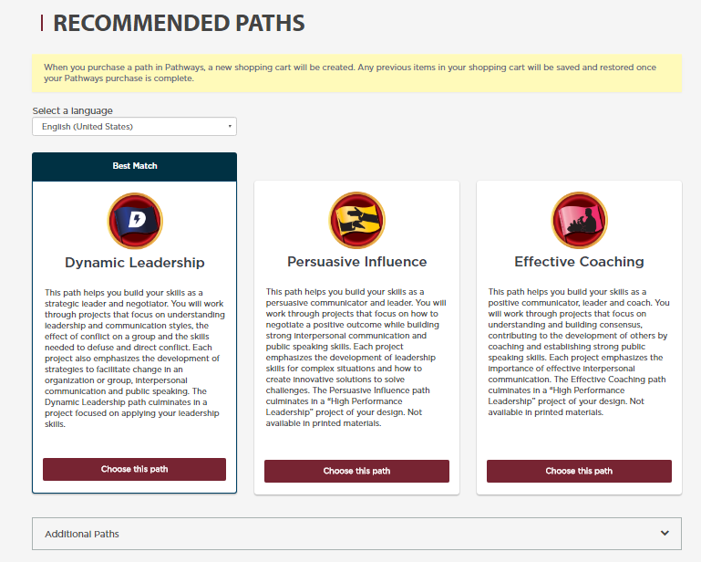

Slide 12
For More Details on Any Path
Pathways area on the D57 website:
www.d57tm.org/pathways/
Get the D57 catalog file (pdf):
“Pathways Path and Projects Catalog”
Has summary of every project

Slide 13
Enter Pathways Select a Path Open Your First Project

Slide 15
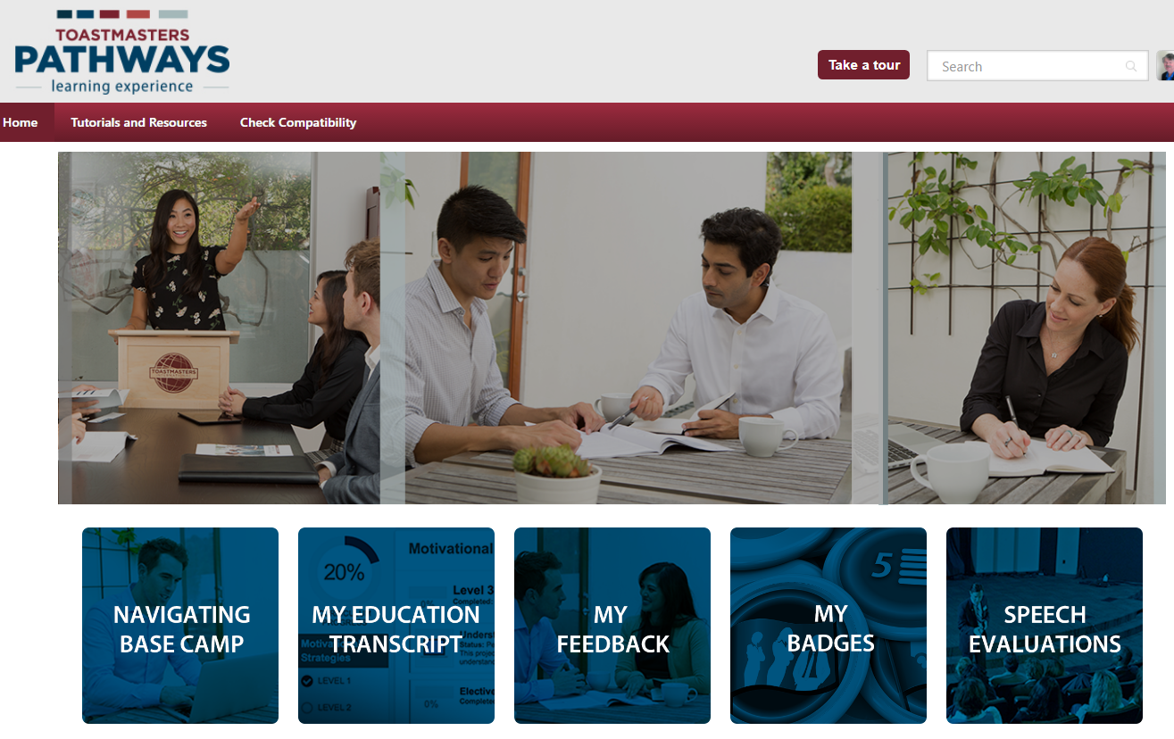

Slide 16
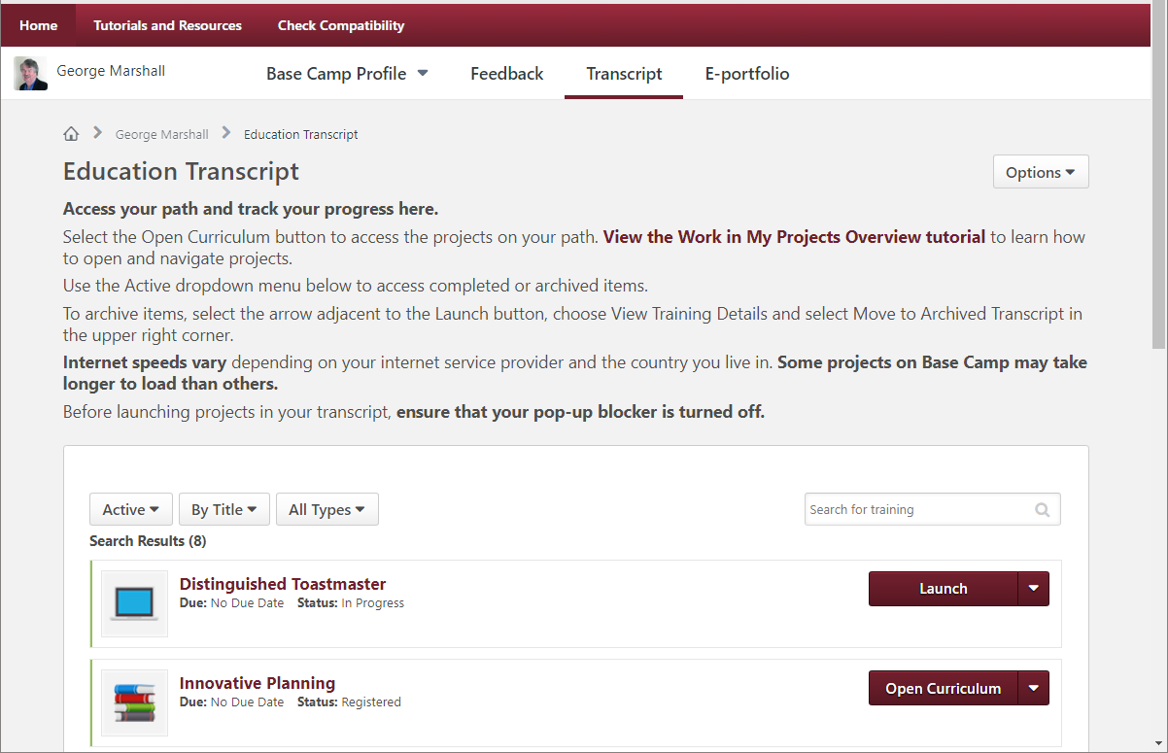

Slide 17
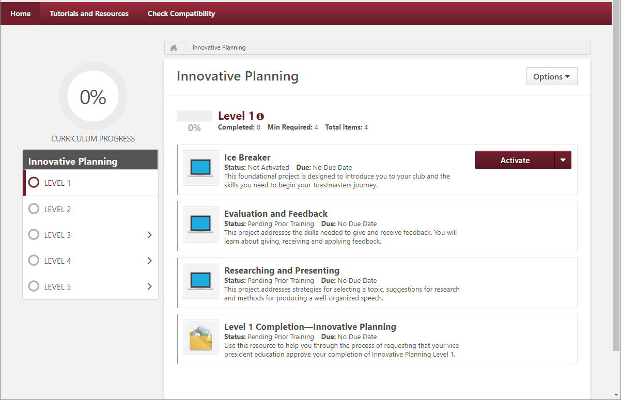

Slide 18
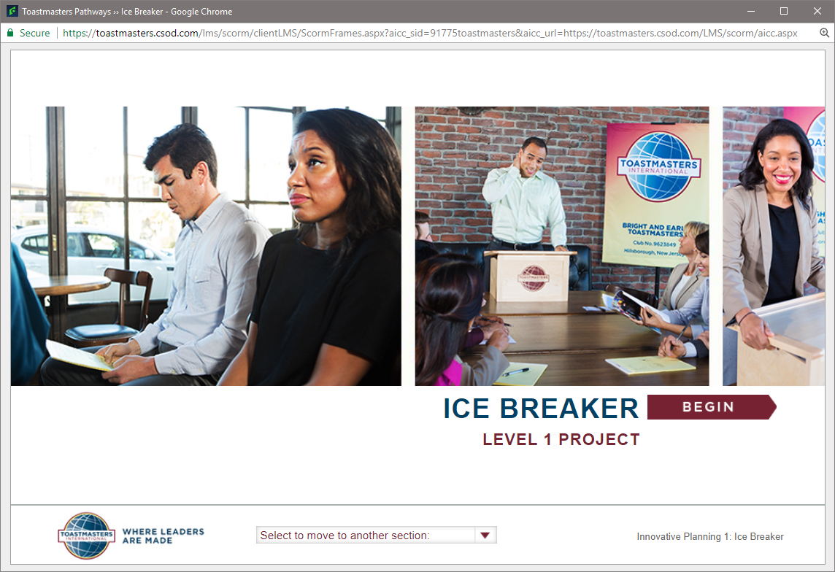

Slide 19
Download this Presentation d57tm.org/pathways

Slide 20
Let’s Get Started on Pathways!

Slide 22
Completing Projects, Levels and Awards Online

Slide 23
Completing Projects, Levels and Awards Online Who Does What?
Member
Complete a project - give the speech
Then re-open project, complete Assess Skills-After

Slide 24
Reopen Project in Base Camp

Slide 25
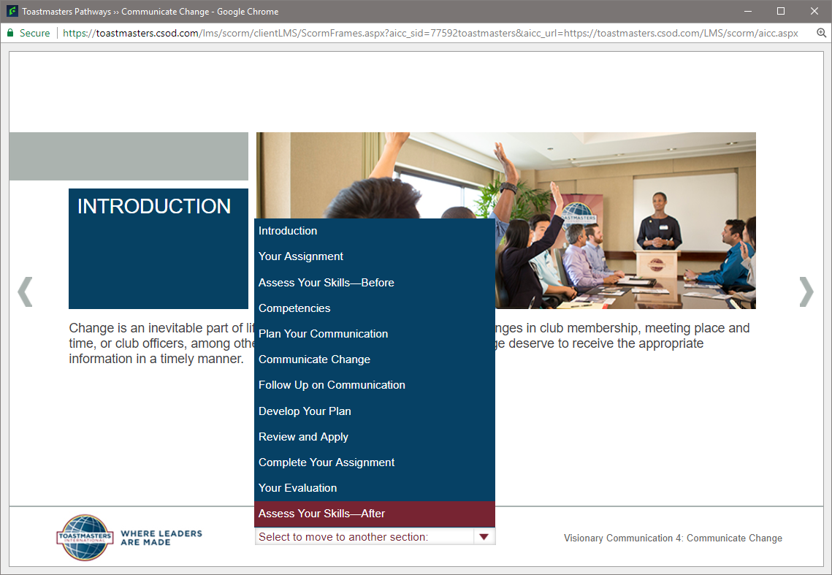

Slide 26
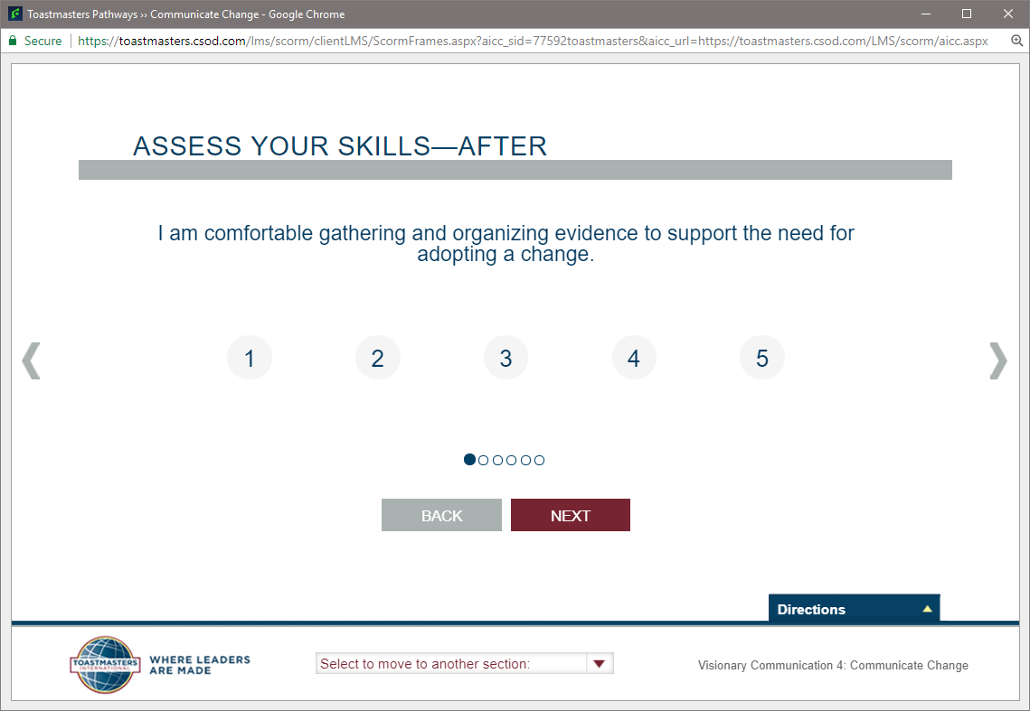

Slide 27
Completing Projects, Levels and Awards Online
Member
Complete a project
Re-open project, complete Assess Skills-After
No approval needed
Complete a level
Run the “Level Completion” task in your path

Slide 28
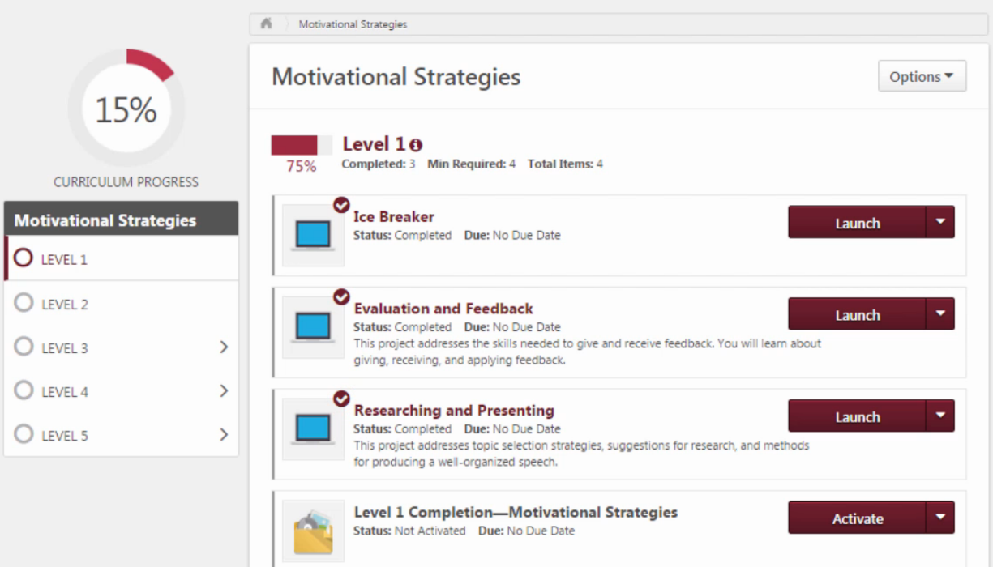

Slide 29
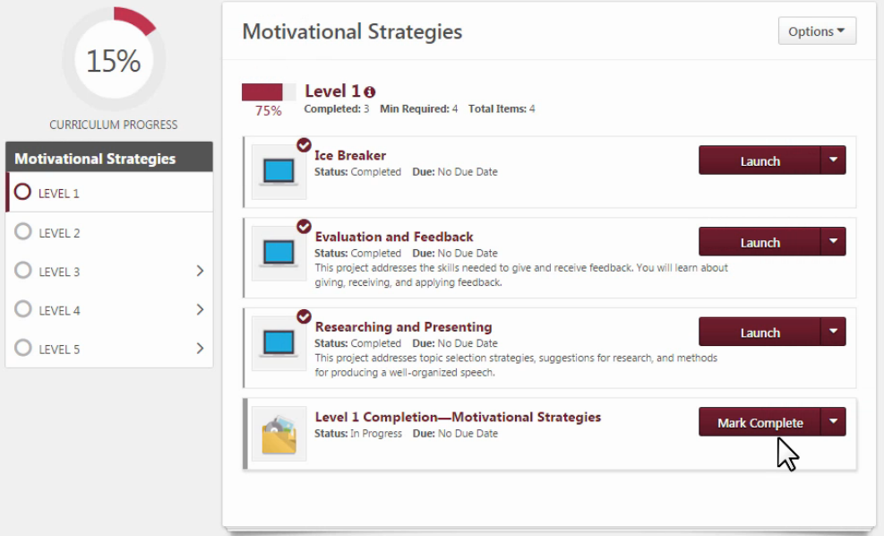

Slide 30
Completing Projects, Levels and Awards Online
Member
Complete a project
Re-open project, complete Assess Skills-After
Complete a level
Run the “Level Completion” task
Notify your VPE and base camp managers – Level completion must be approved to see details of projects in next level
Base Camp Manager (VPE, Pres or Secy)
Mark the member’s level as Approved
Member can now proceed to next level

Slide 31
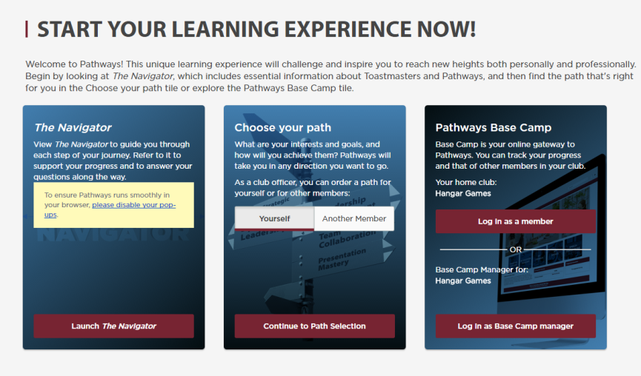
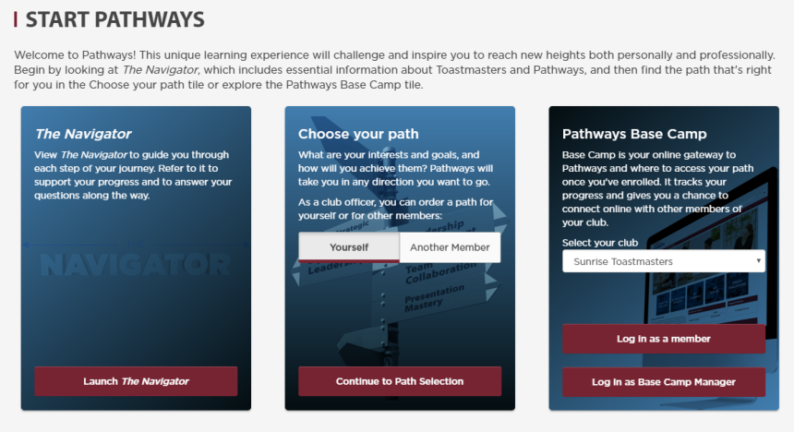

Slide 32
Completing Projects, Levels and Awards Online
Member
Complete a project
Re-open project, complete Assess Skills-After
Complete a level
Run the “Level Completion” task
Notify your VPE and base camp managers – Level completion must be approved to see details of projects in next level
Base Camp Manager (VPE, Pres or Secy)
Mark the member’s level as Approved
Member can now proceed to next level
VPE (or Any Officer)
Submit Level award in Club Central

Slide 33
What Can YOU Do to Help?

Slide 34
Get Started on Pathways!
Why?
Understand the Program
Set a Great Example!

