Slide 2
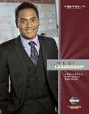
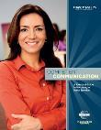
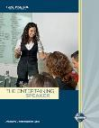
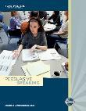
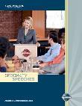
Traditional Program Chart to DTM
Club Officer+
District Officer Sponsor/Mentor/Coach HPL
DTM
Speechcraft,
YLP, et al
Educ.

Slide 3
Pathways Chart to DTM
District Officer
Club Officer-12 mo
Club Mentor or
Club Coach
Club Sponsor or
Speechcraft or Youth Leadership Program
DTM PROJECT “Capstone”
DTM
New Member

Slide 4
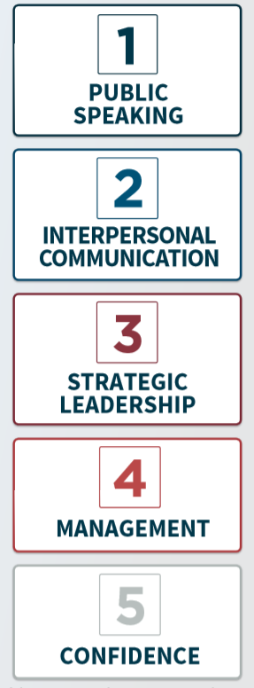

Slide 5
Levels and Project Types
Level 1 Mastering Fundamentals | Level 2 Learning Your Style | Level 3 Increasing Your Knowledge | Level 4 Building Skills | Level 5 Demonstrating Expertise
‘Icebreaker’ + Evaluation and Feedback + Researching and Presenting | Two required projects + Introduction to Toastmasters Mentoring | One required project + a minimum of two Electives Serve as Topics Master Toastmaster and Evaluator by end of Level 3 | One required project + a minimum of one Elective | One required project + a minimum of one Elective + ‘Reflect on Your Path’

Slide 6
Evaluations

Slide 7
Evaluations

Slide 8
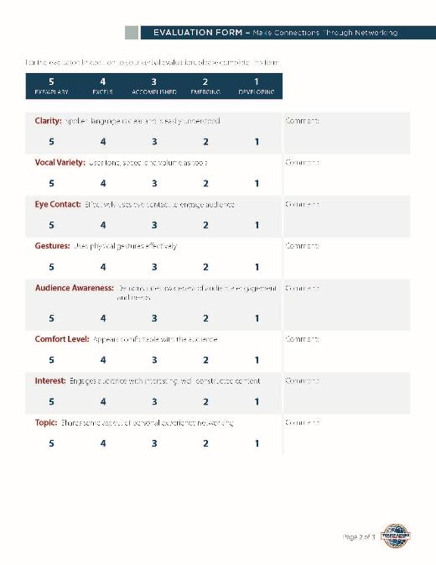

Slide 9
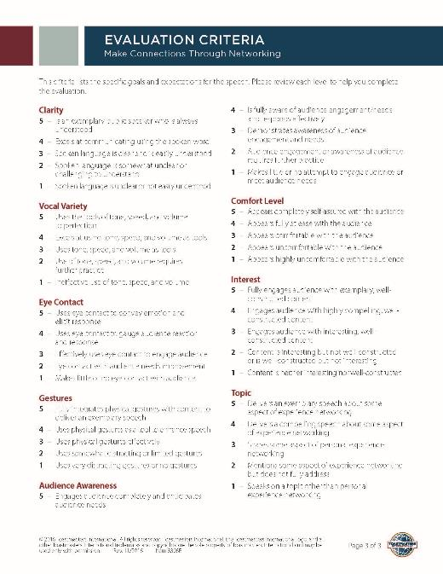
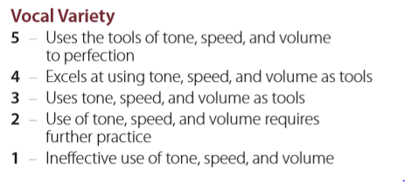

Slide 10
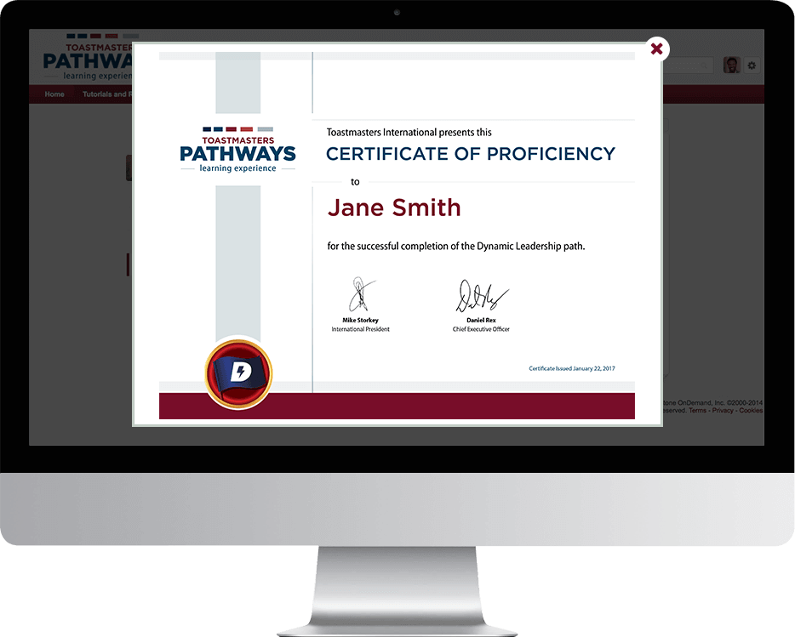
Badges and Awards

Slide 12
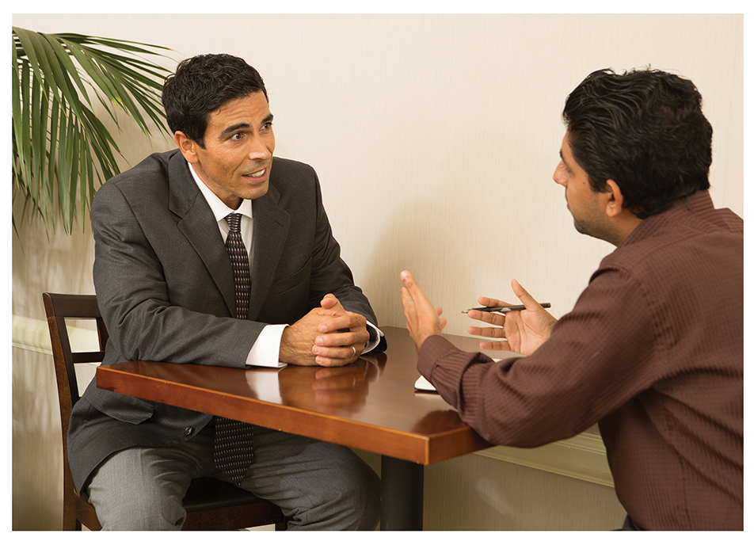
PATHWAYS MENTOR PROGRAM

Slide 13
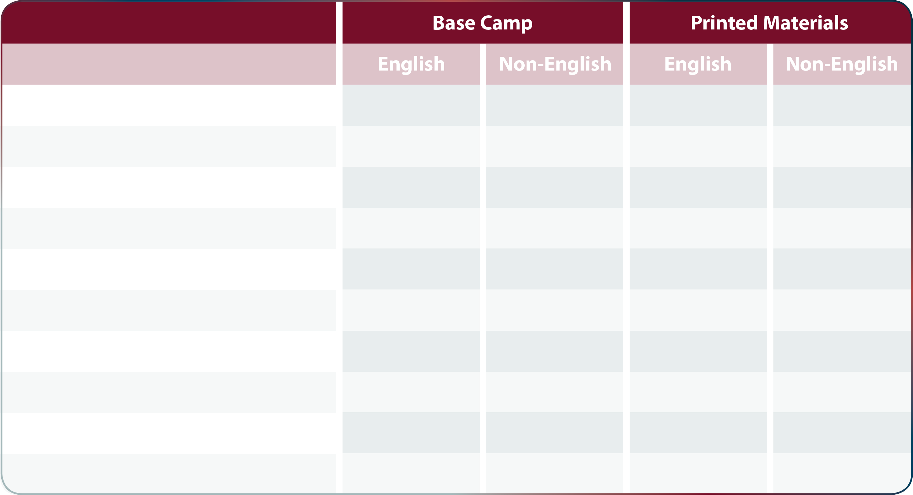
CHOOSING YOUR EXPERIENCE: PRINTED MATERIALS
Dynamic Leadership
✔
✔
✔
Effective Coaching
✔
✔
Innovative Planning
✔
✔
Leadership Development
✔
✔
✔
✔
Motivation Strategies
✔
✔
Persuasive Influence
✔
✔
Presentation Mastery
✔
✔
✔
✔
Strategic Relationships
✔
✔
✔
Team Collaboration
✔
✔
✔
Visionary Communication
✔
✔

Slide 14
REACHING YOUR CURRENT EDUCATION GOALS
Transition period
Through June 2020
Both programs active
During transition, existing members may
Continue on traditional program
Start on Pathways
Work both concurrently
Reinstated members
Same choices as existing members
New members go on Pathways
Current awards do not apply towards Pathways awards
After transition, no “old” awards granted
You keep all traditional awards

Slide 15
Pathways Doesn’t Change the Club Meeting

Slide 16
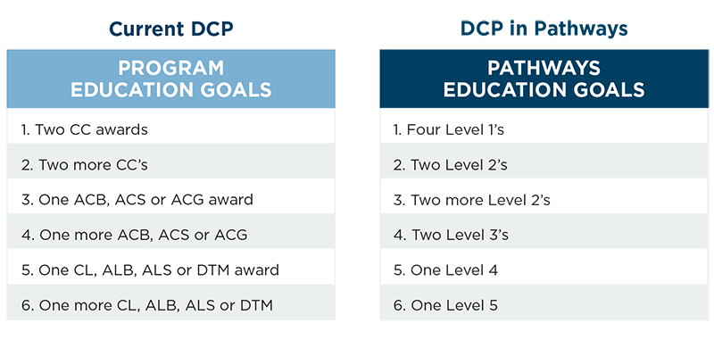
Select ANY six of the 12 goals
DISTINGUISHED CLUB PROGRAM

Slide 17
The Hardest Part of Any New Project …
Getting Started!

Slide 18
Enter Pathways
Select a Path
Open Path
Launch Your First Project
Submit Awards

Slide 19
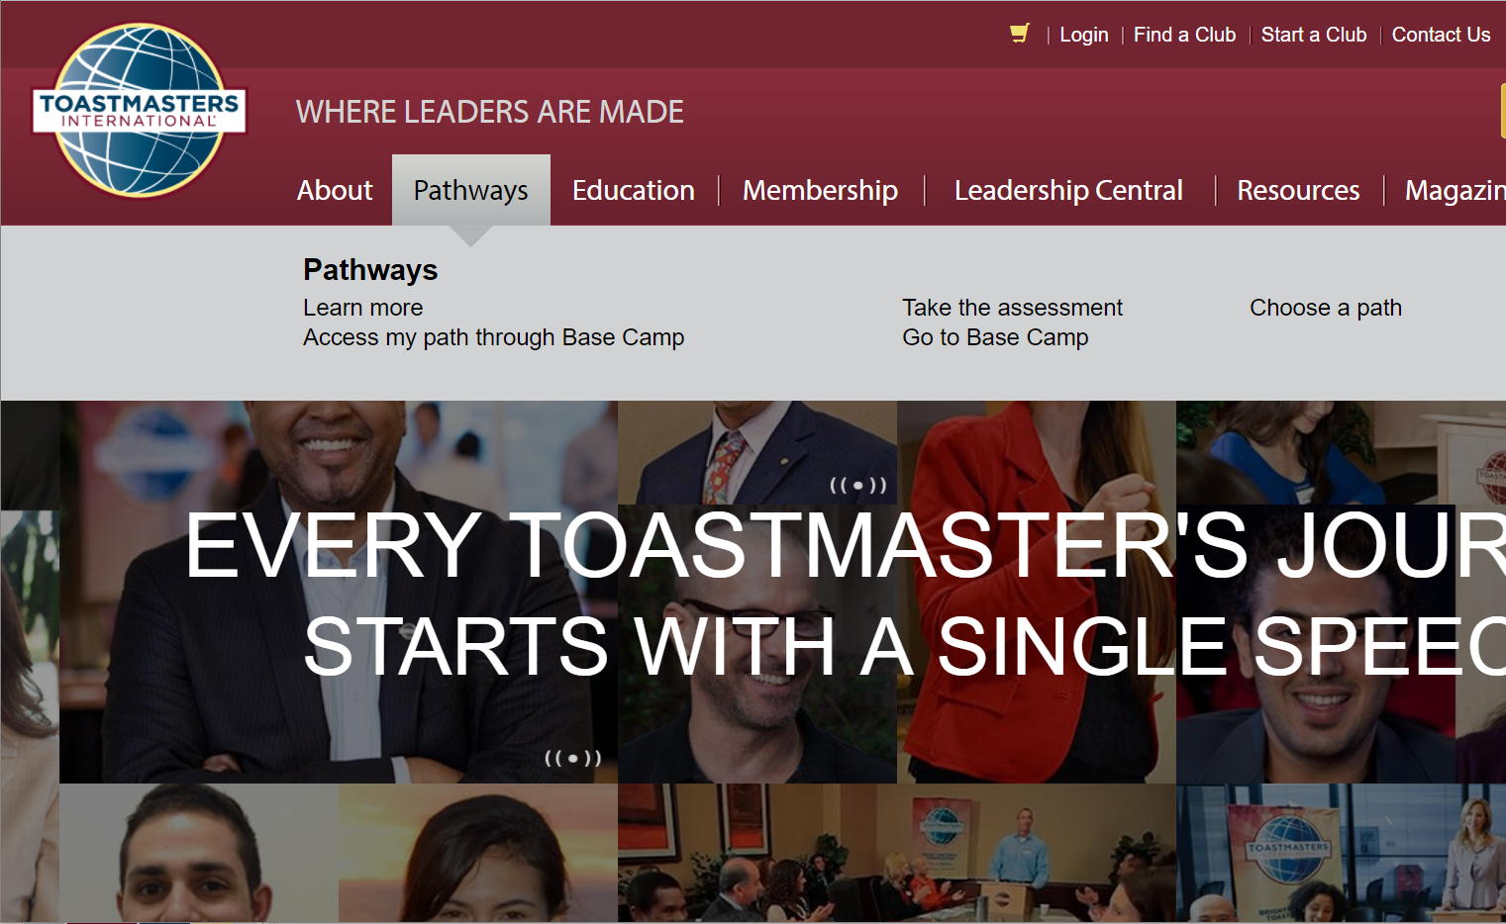

Slide 20
Login, or setup your account

Slide 21
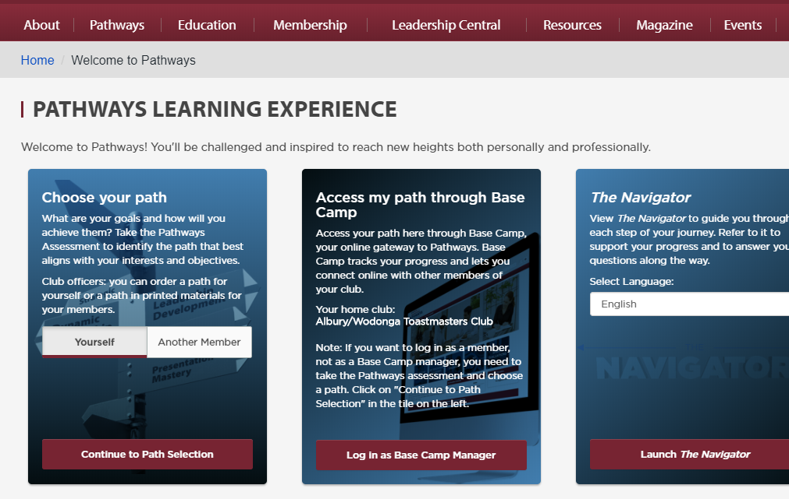

Slide 22
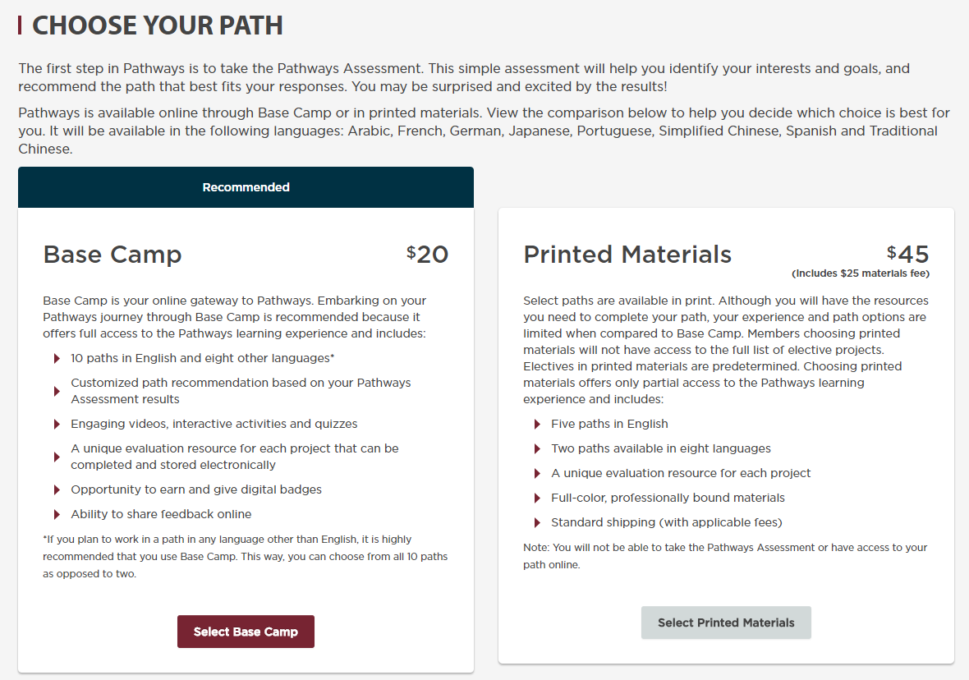
Free
$25
Select an Online Path
Select a Printed Path

Slide 23
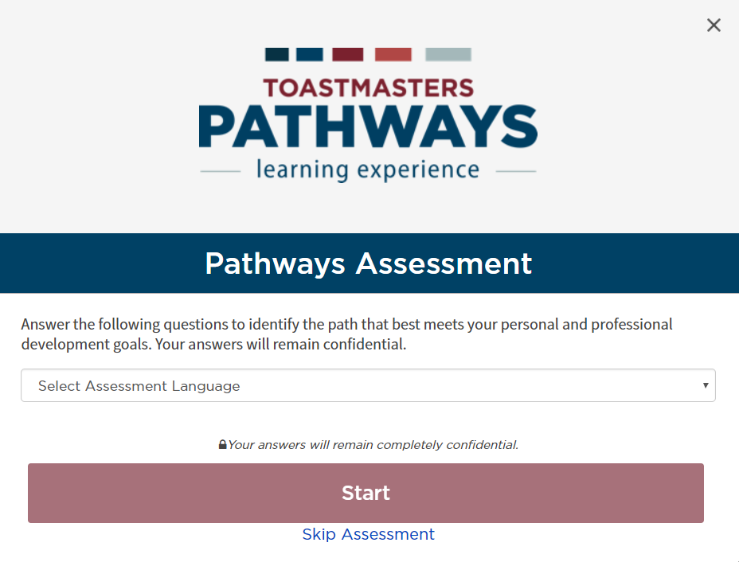

Slide 24
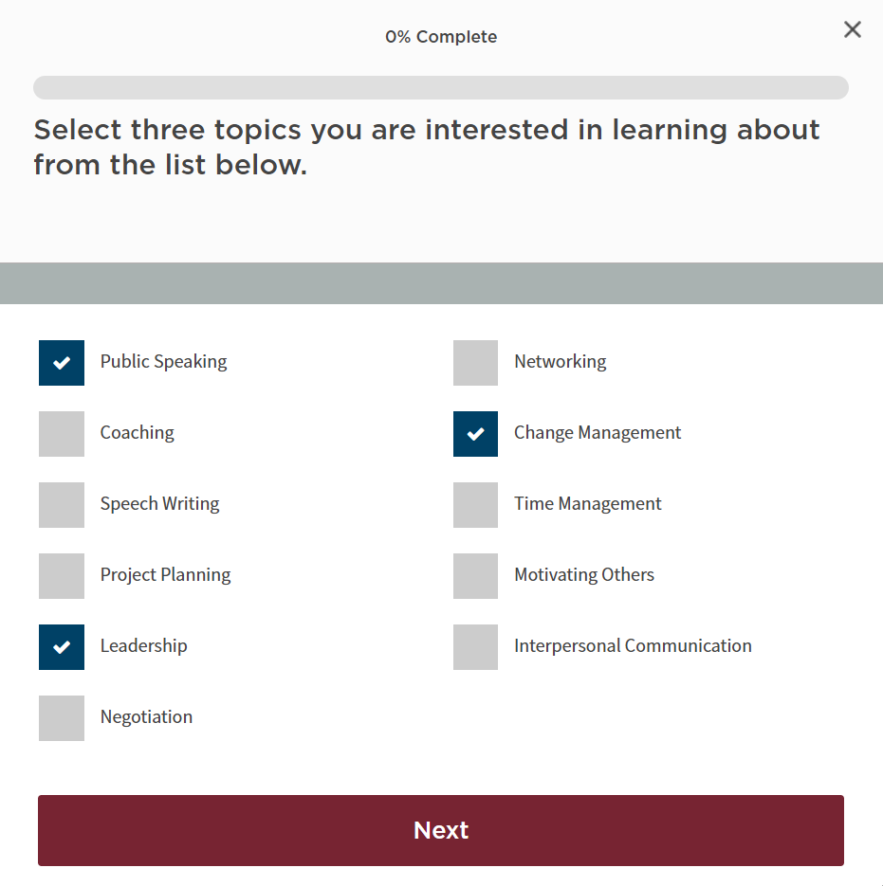

Slide 25
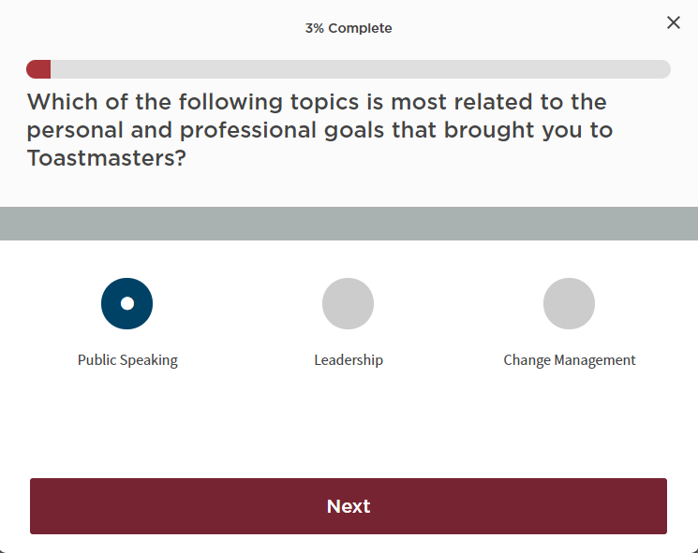

Slide 26
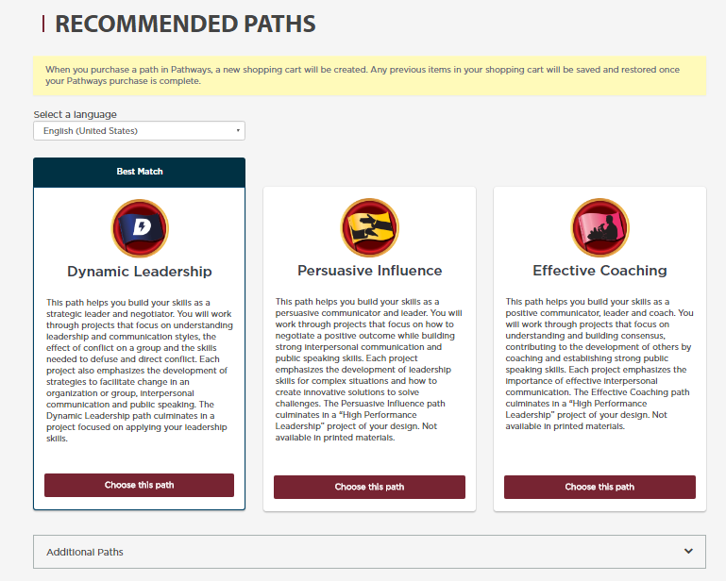

Slide 27
For More Details on Any Path
Pathways area on the D57 website:
www.d57tm.org/pathways/
Get the D57 catalog file (pdf):
“Pathways Path and Projects Catalog”
Very Useful Resource!

Slide 28
Enter Pathways
Select a Path
Open the Path
Launch Your First Project
Submit Awards

Slide 29
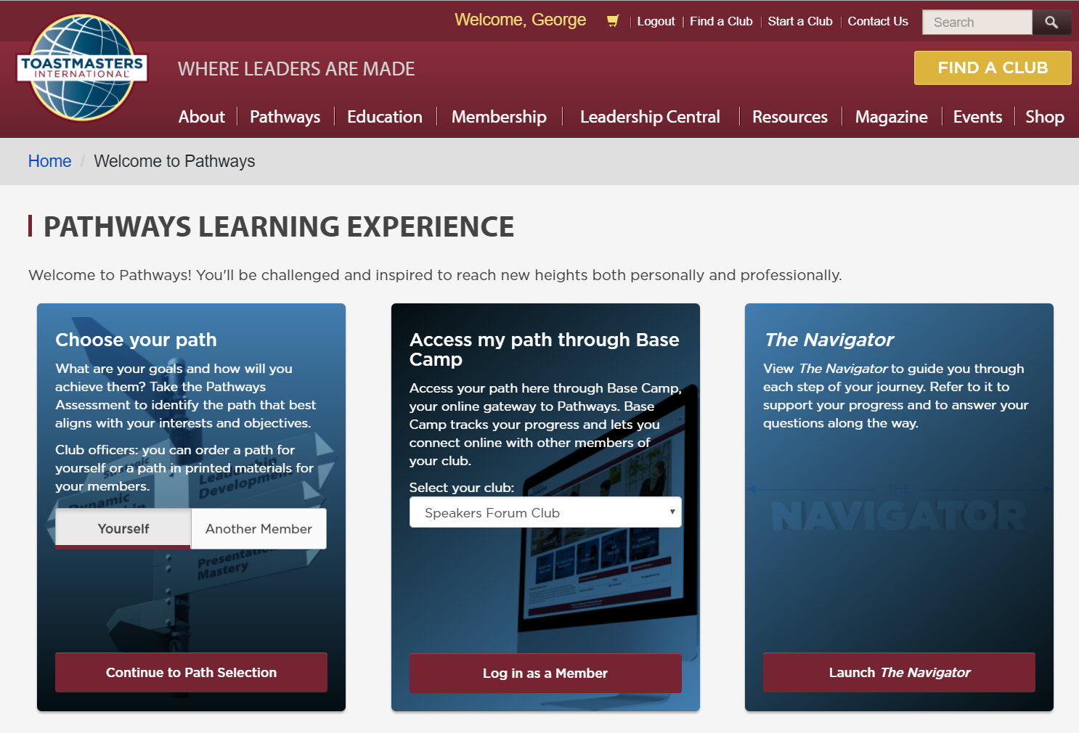

Slide 30
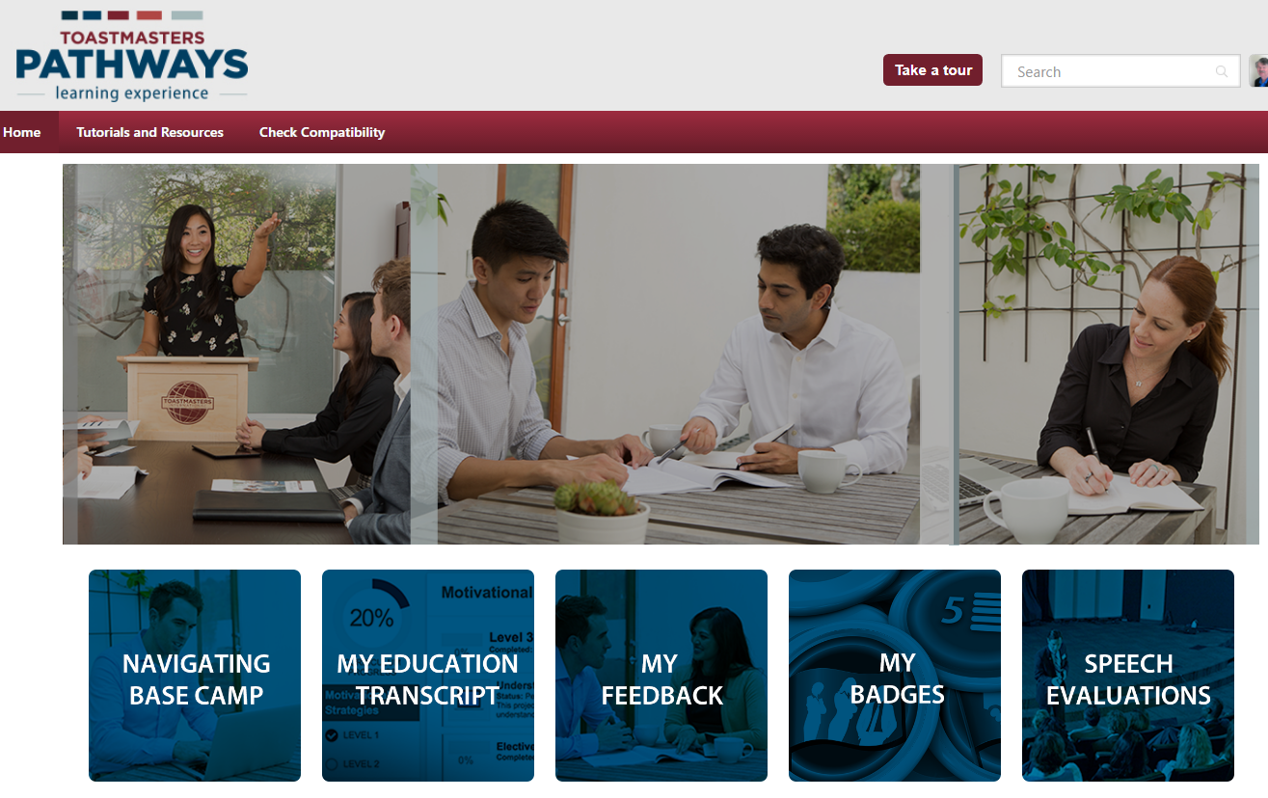

Slide 31
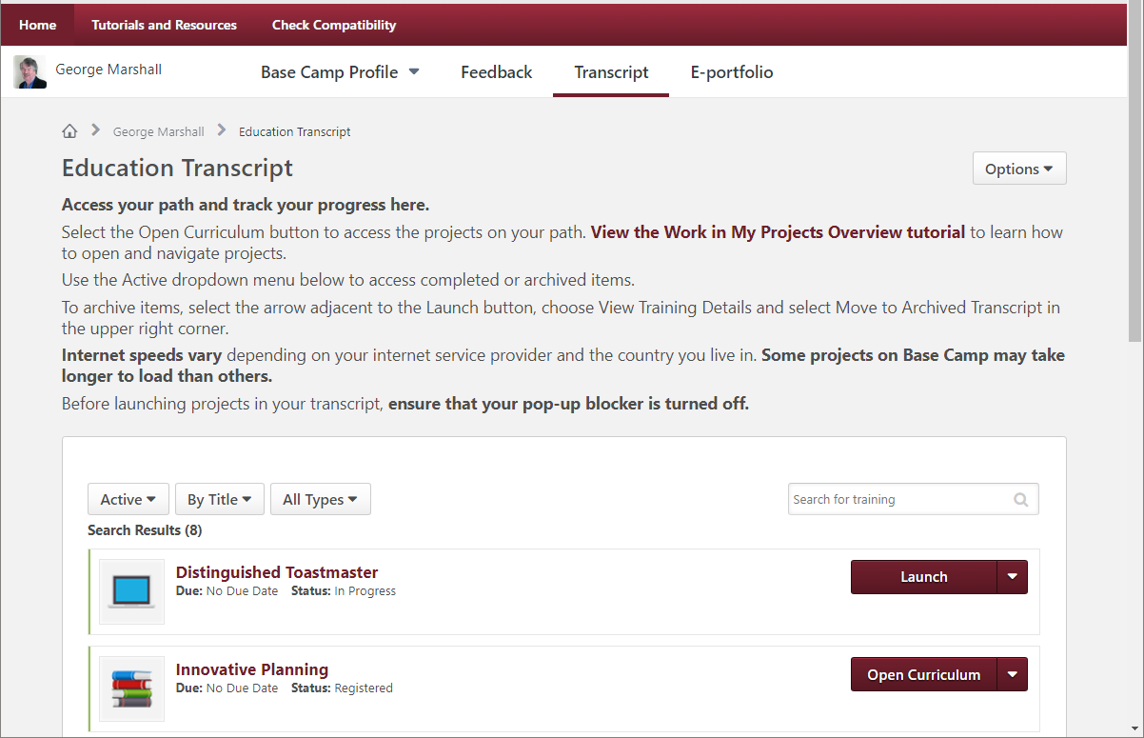

Slide 32
Enter Pathways
Select a Path
Open Path
Launch Your First Project
Submit Awards

Slide 33
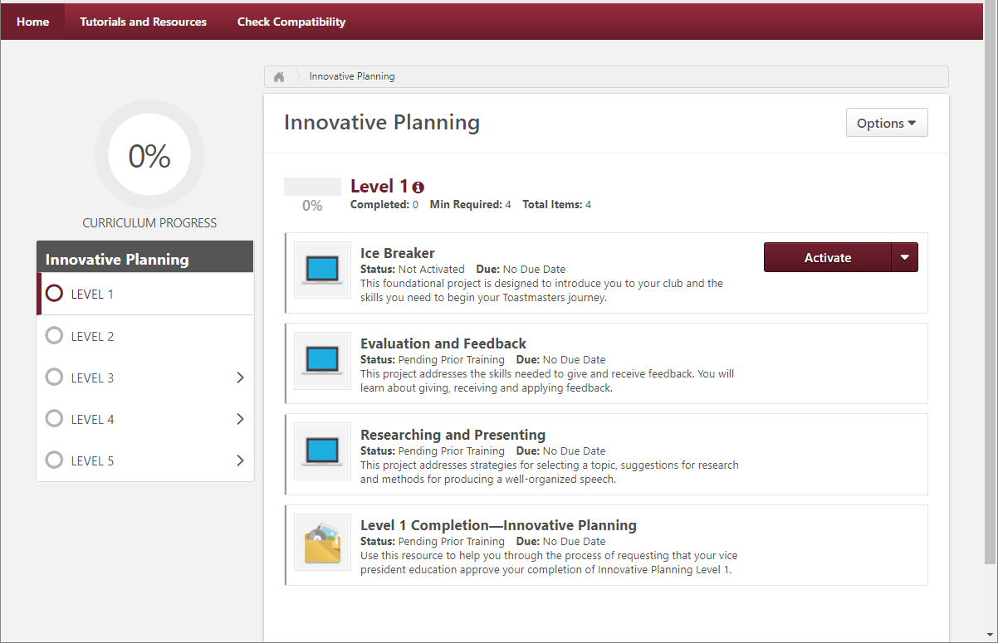

Slide 34
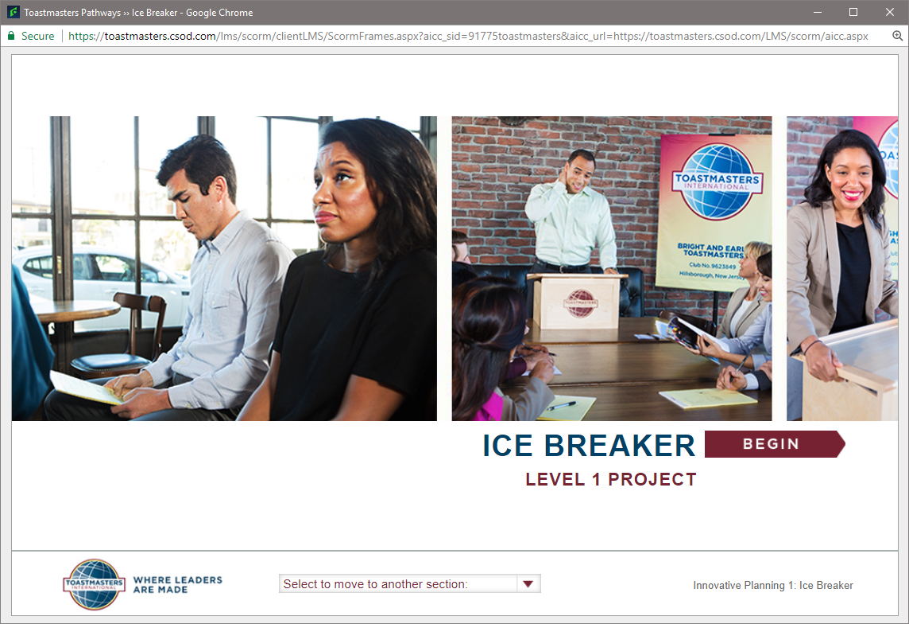

Slide 35
Enter Pathways
Select a Path
Open Path
Launch Your First Project
Submit Awards

Slide 36
Completing Projects, Levels and Awards Online Who Does What?
Member
Complete a project - give the speech
Then re-open project, complete Assess Skills-After

Slide 37
Reopen Project in Base Camp

Slide 38
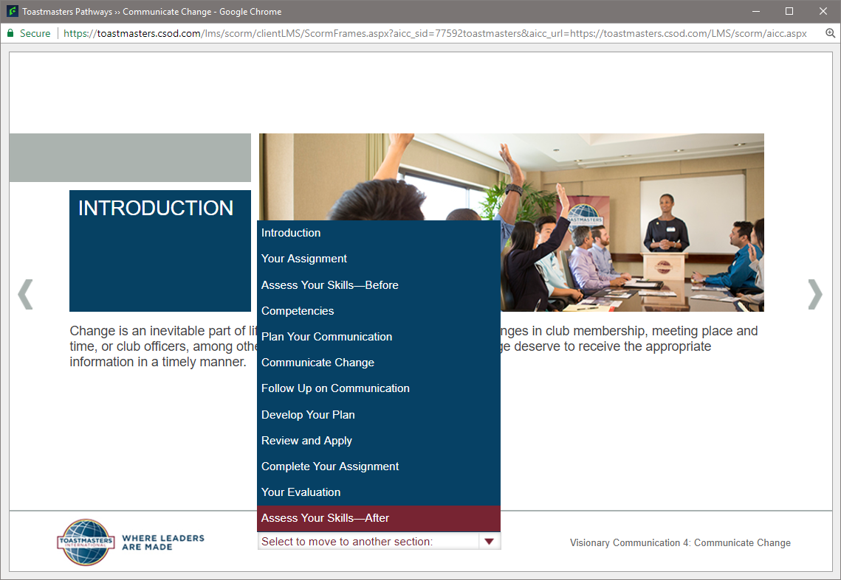

Slide 39
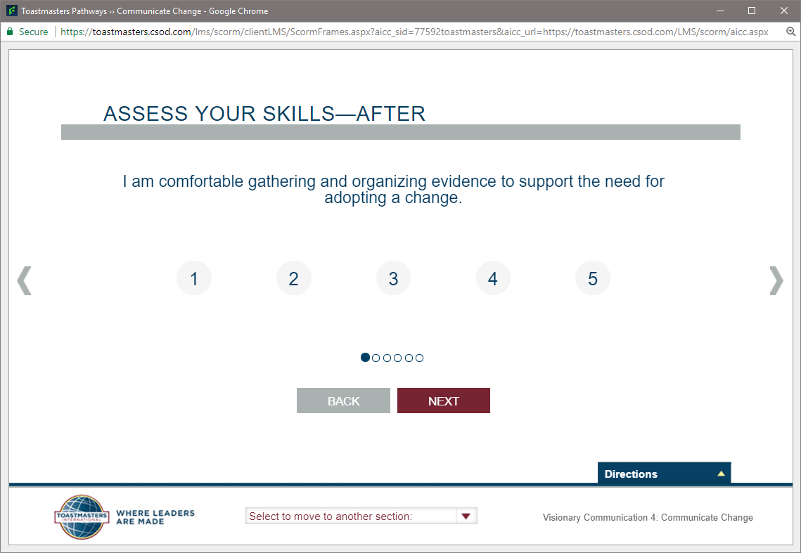

Slide 40
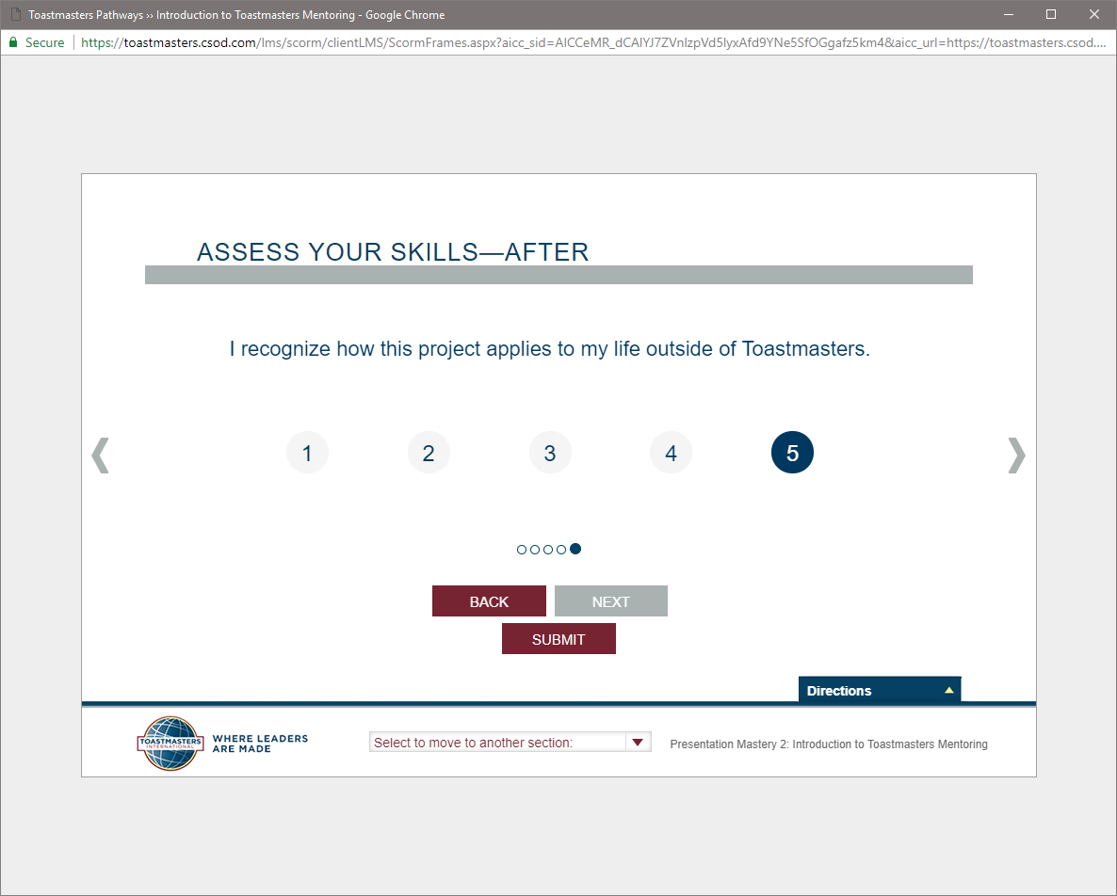
Click ‘Submit’ on last screen!

Slide 42
Completing Projects, Levels and Awards Online
Member
Complete a project
Re-open project, complete Assess Skills-After
No approval needed to continue
Complete a level
Run the “Level Completion” task in your path

Slide 43
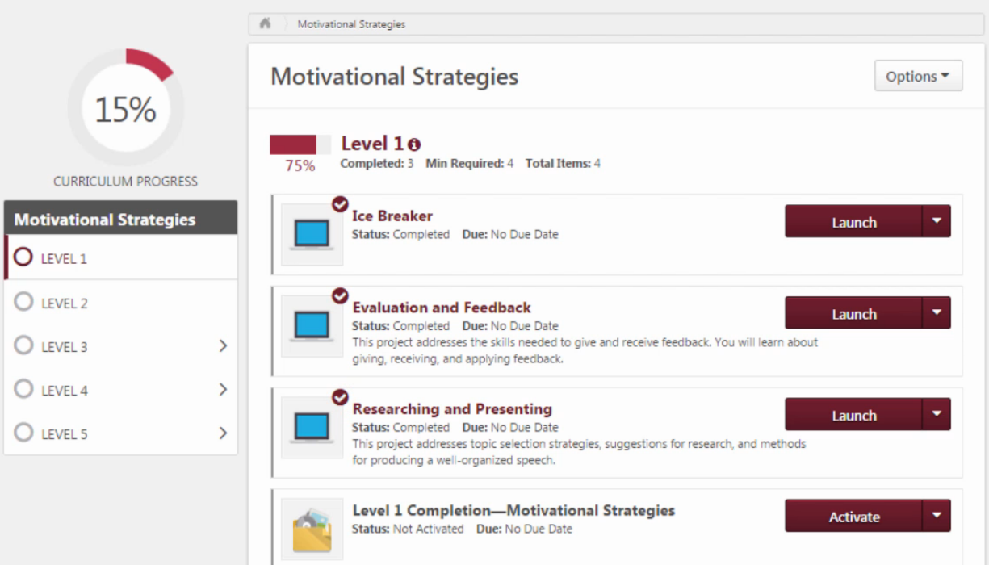

Slide 44
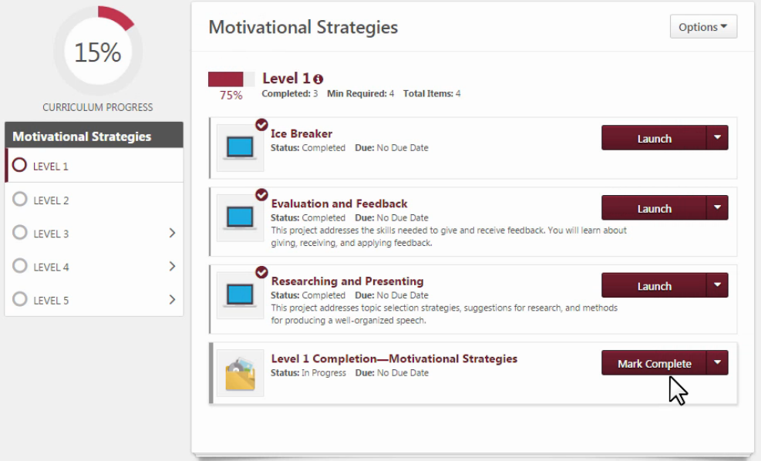

Slide 45
Completing Projects, Levels and Awards Online
Member
Complete a project
Re-open project, complete Assess Skills-After
Complete a level
Run the “Level Completion” task
Notify your VPE and base camp managers – Level completion must be approved to move on
Base Camp Manager (VPE, Pres or Sec)
Mark the member’s level as Approved

Slide 46
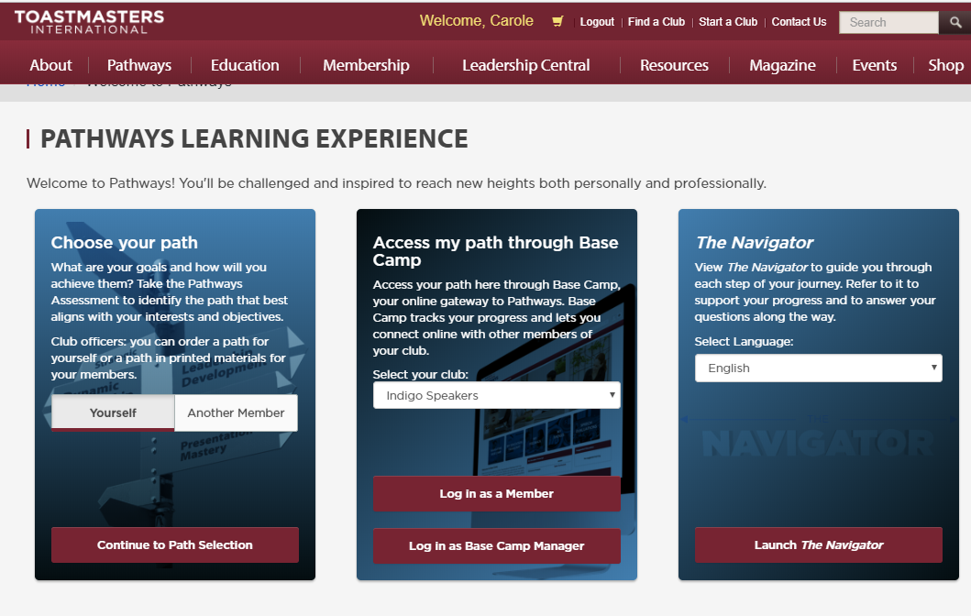

Slide 49
Completing Projects, Levels and Awards Online
Member
Complete a project
Re-open project, complete Assess Skills-After
Complete a level
Run the “Level Completion” task
Notify your VPE and base camp managers – Level completion must be approved to move on
Base Camp Manager (VPE, Pres or Sec)
Mark the member’s level as Approved
Member can now proceed to next level !
VPE (or Any Officer)
Approving a Level does NOT submit the award
Submit Level award in Club Central

