Slide 2
The Hardest Part of Any New Project …
Getting Started!

Slide 3
Enter Pathways
Select a Path
Open Path
Launch Your First Project
Submit Awards

Slide 4
Login with your name and self-chosen password. Your name will appear in burgundy banner – click on your name.

Slide 5
Login, or setup your account

Slide 6
After you click on your name, this page appears. Click on the middle tile,
“Choose a New Path” to take the assessment and choose a Path

Slide 7
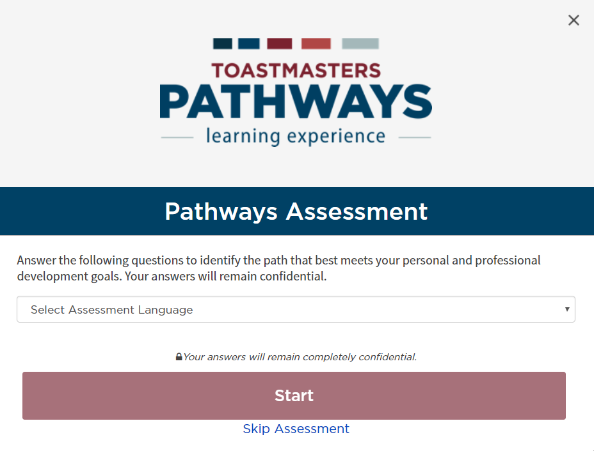

Slide 8
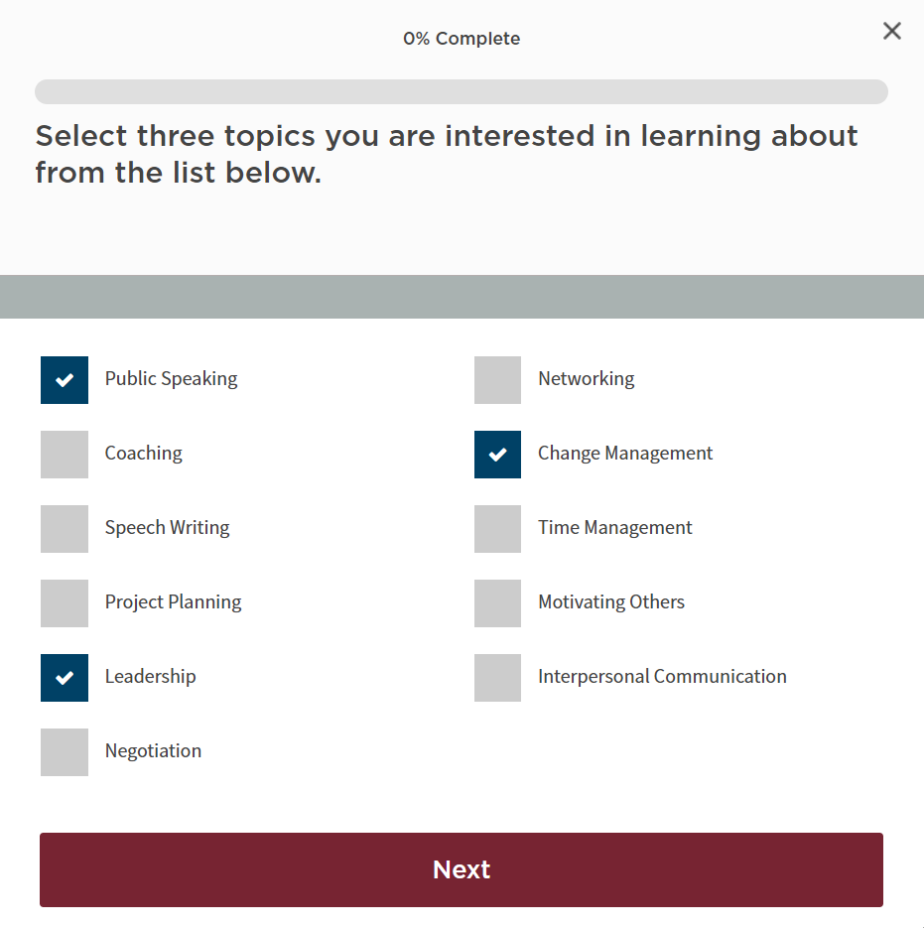

Slide 9
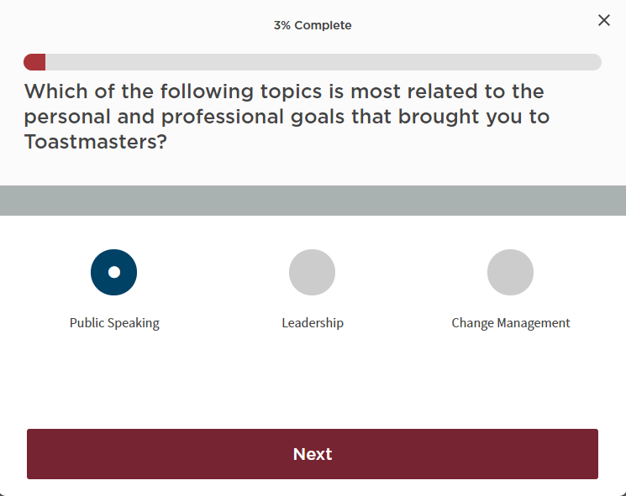

Slide 10
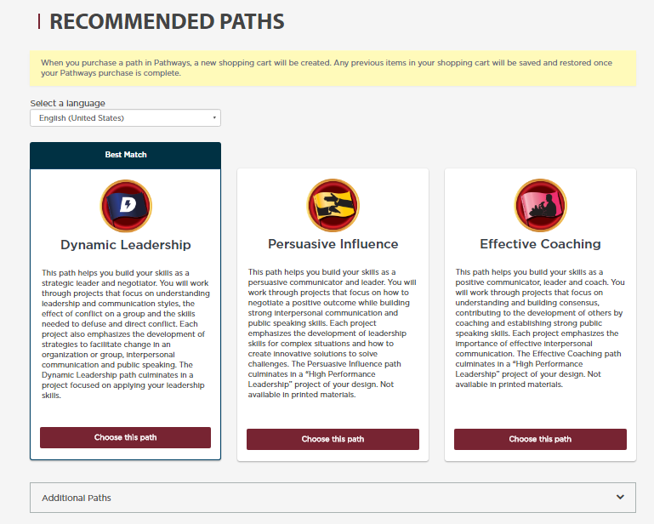
You can select one of the recommended Paths or any Path of your choice.

Slide 11
For More Details on Any Path
Pathways area on the D57 website:
www.d57tm.org/pathways/
Get the D57 catalog file (pdf):
“Pathways Path and Projects Catalog”
Very Useful Resource!

Slide 12
Enter Pathways
Select a Path
Open the Path
Launch Your First Project
Submit Awards

Slide 13
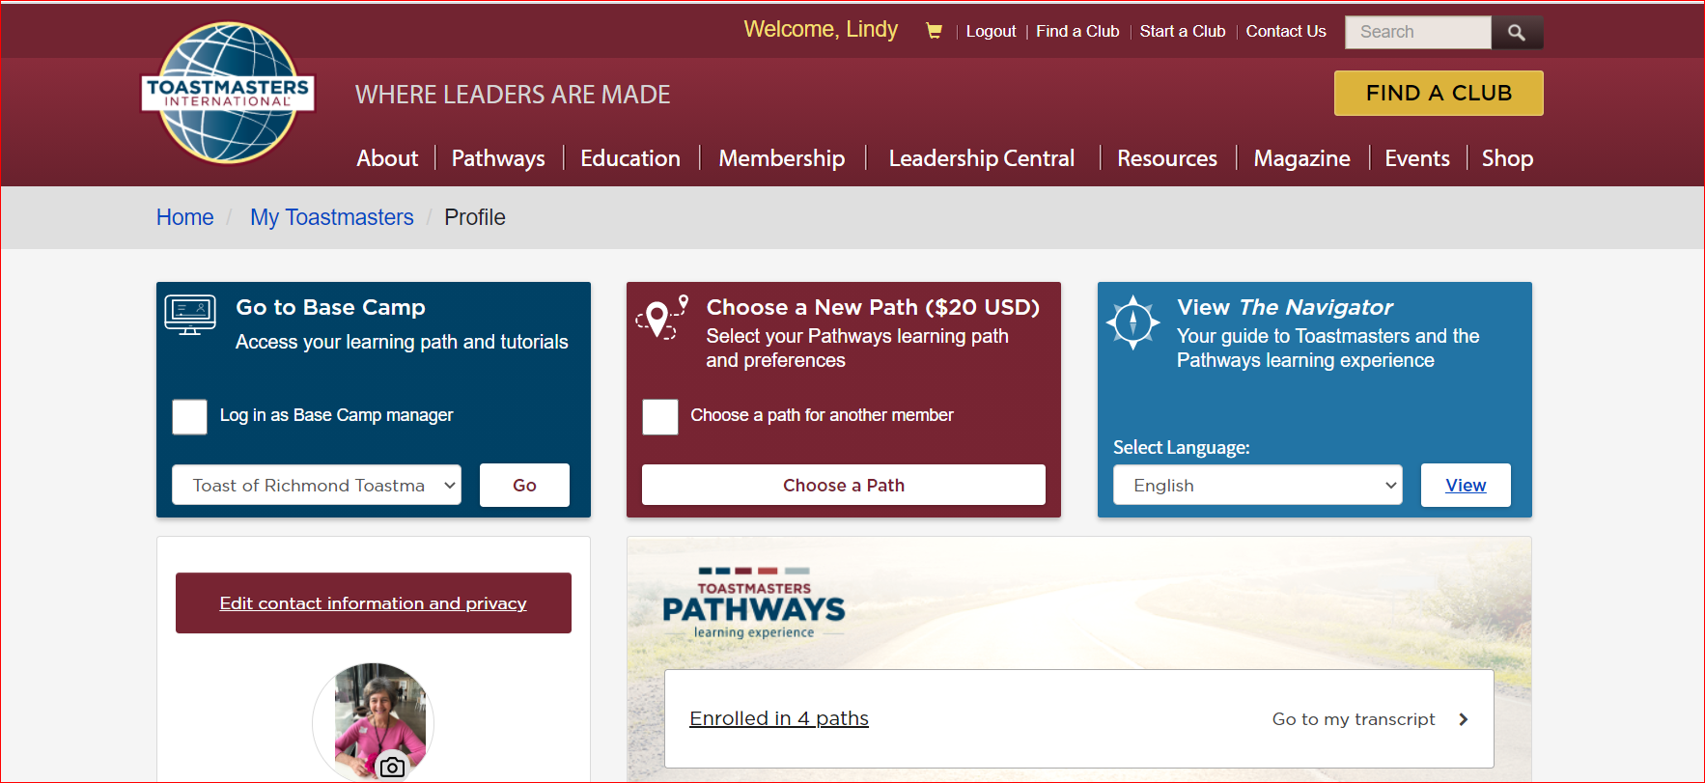
Click above to go to your path. It will show the name
of your path instead of “Enrolled in 4 paths”.

Slide 14
Click on “Open Curriculum”
Click on “Launch” to launch your first project

Slide 15
Click drop-down menu at bottom of page and gradually go through each of the menu items through “Your Evaluation”. Come back after your speech to complete “Assess Your Skills – After”.

Slide 16
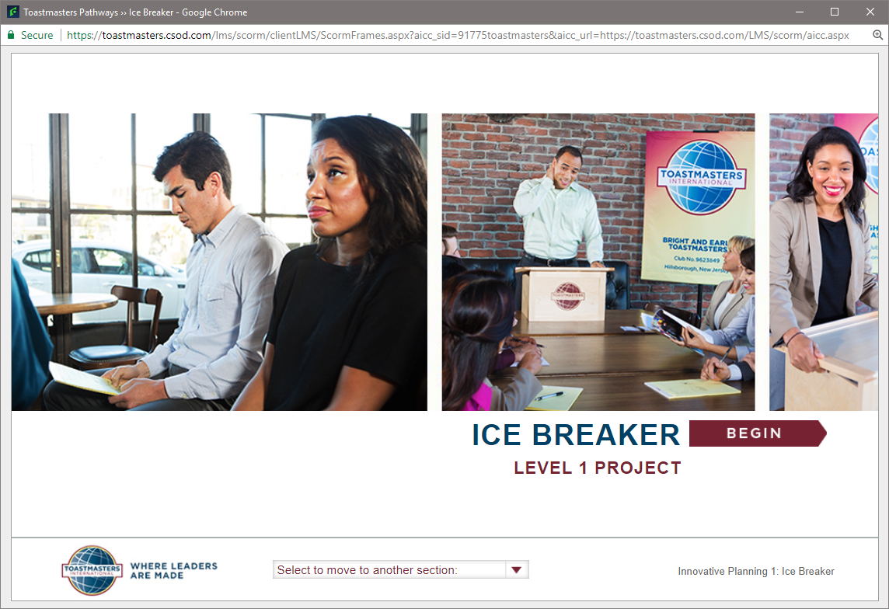

Slide 17
Enter Pathways
Select a Path
Open Path
Launch Your First Project
Submit Awards

Slide 18
Completing Projects, Levels and Awards Online Who Does What?
Member
Complete a project - give the speech
Then re-open project, complete Assess Skills-After

Slide 19
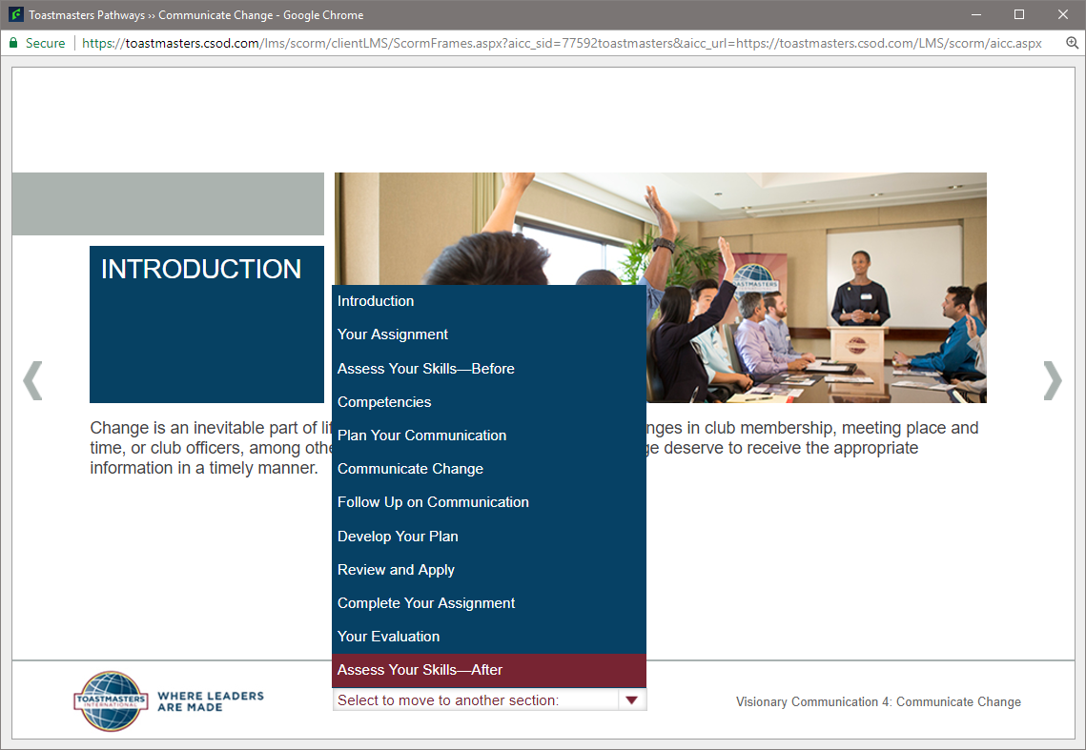

Slide 20
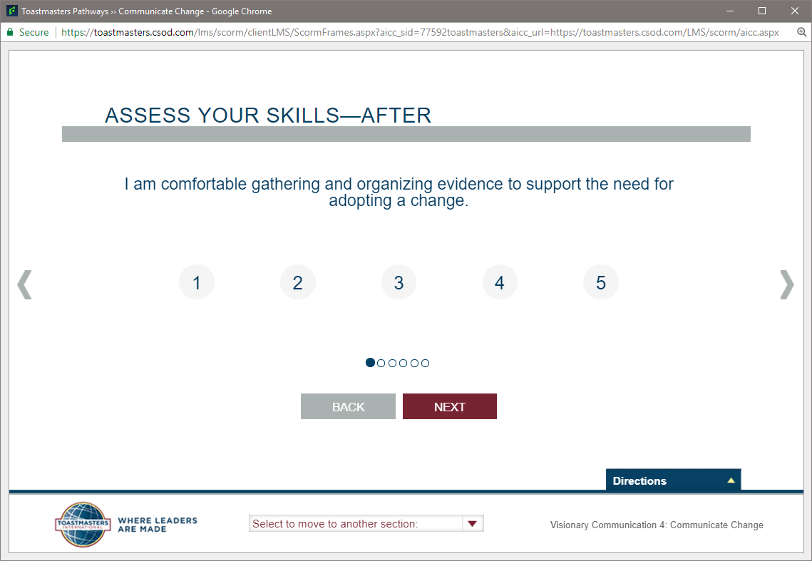

Slide 21
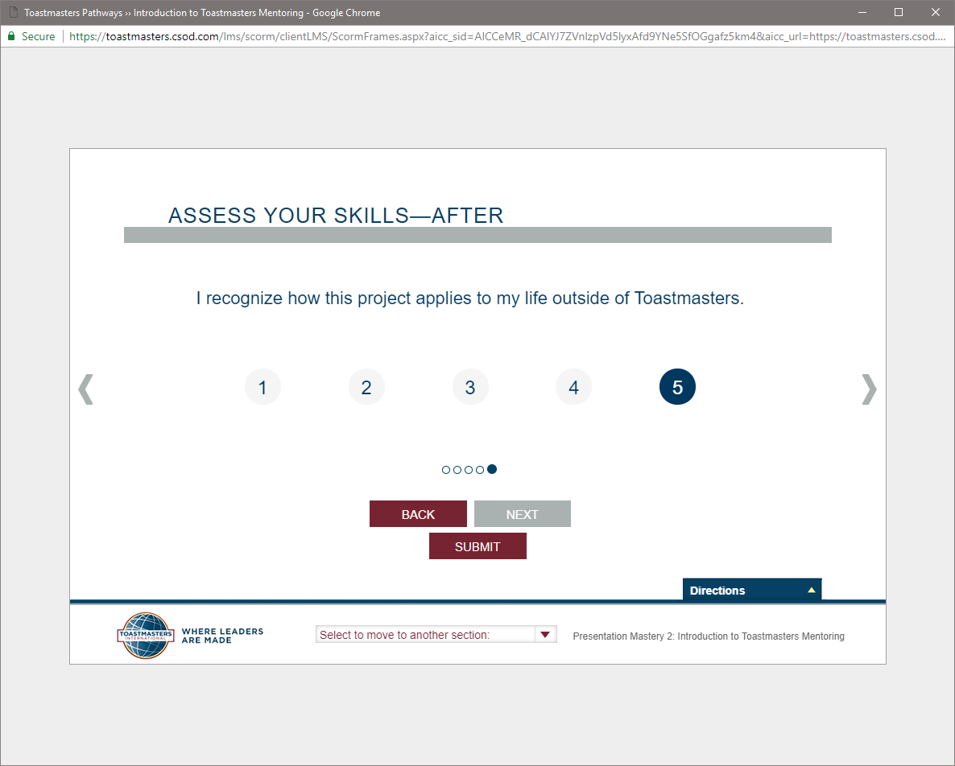
Click ‘Submit’ on last screen!

Slide 23
Completing Projects, Levels and Awards Online
Member
Complete a project
Re-open project, complete Assess Skills-After
No approval needed to continue
Complete a level
Run the “Level Completion” task in your path

Slide 24
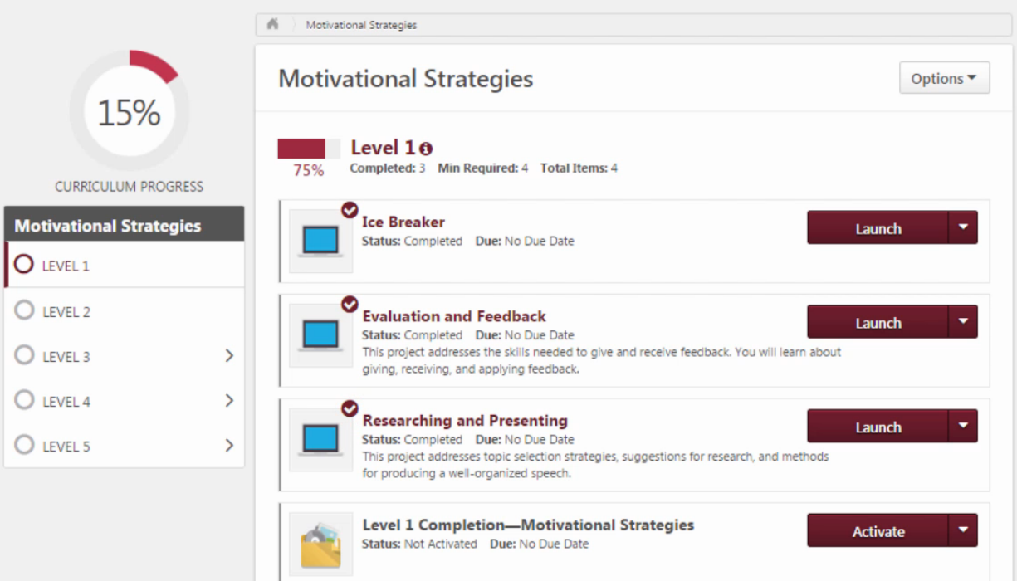

Slide 25
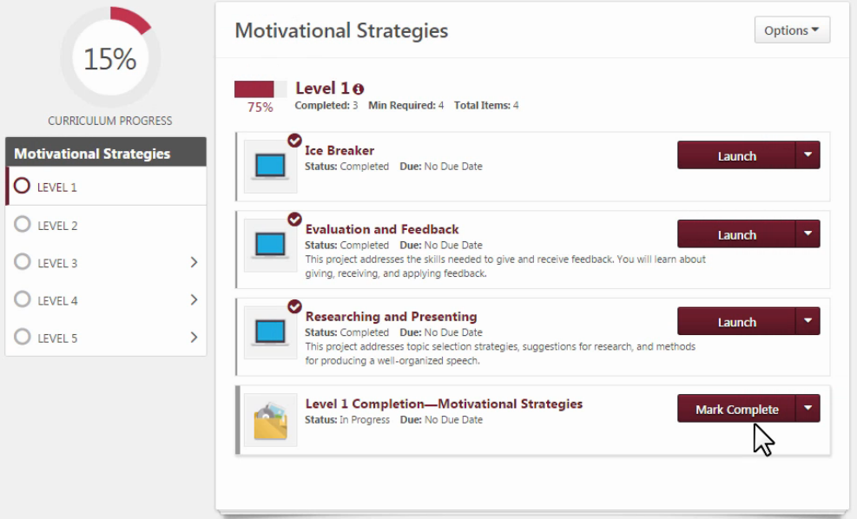

Slide 26
Base Camp Manager duties See “Pending Requests” If member has completed all the requirements for a level, indicate it is approved. Also go to Club Central and indicate the level completion there too.

