Slide 1
Legal Shortcuts in Pathways
Lindy Sinclair, DTM4, Pathways chair
April 1, 2021

Slide 2
1. Fastest way to your current project
Lindy Sinclair, DTM4, Pathways chair
April 1, 2021

Slide 3
Go to www.toastmasters.org and click on “Login” in burgundy banner. Log in with your password.

Slide 4
Your name appears in burgundy banner; click on your name.

Slide 5
This screen appears. Click on “enrolled in xx paths”.

Slide 6
Click on “Open Curriculum”

Slide 7
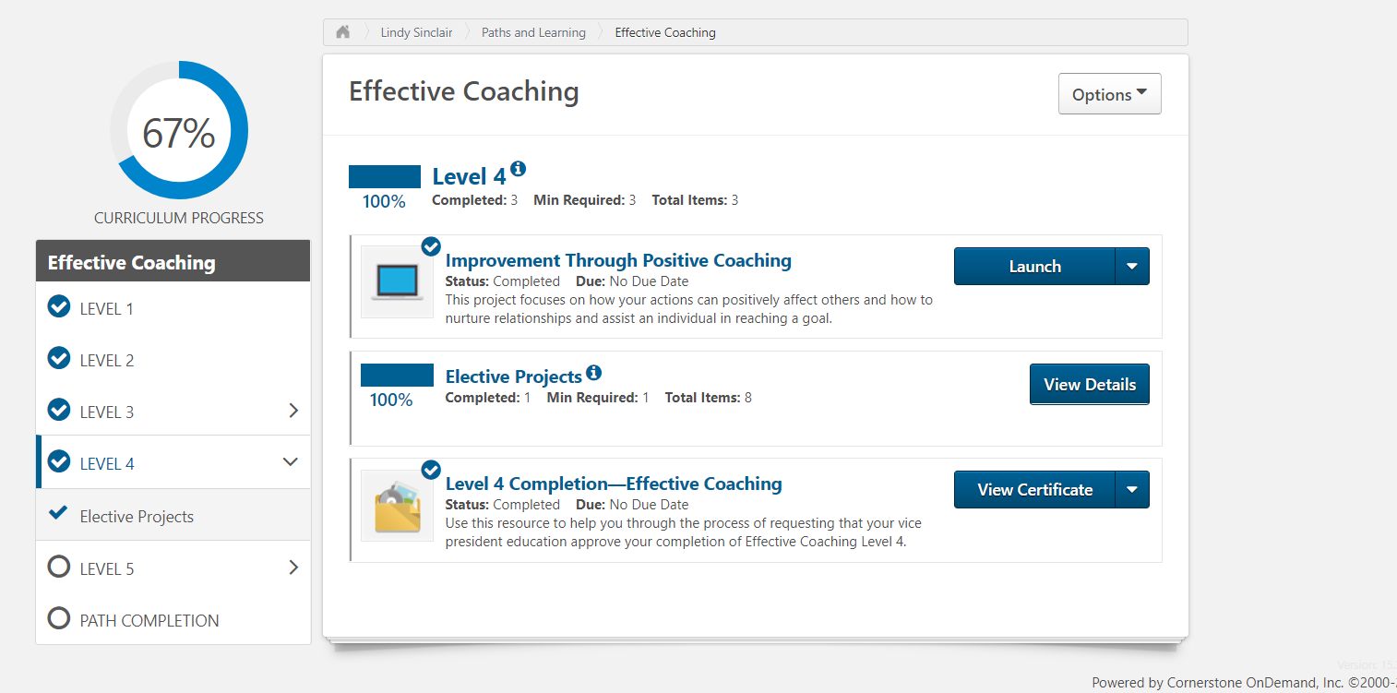
Click on “Launch” in your current project.

Slide 9
2. Fastest way to get details of your current project
Lindy Sinclair, DTM4, Pathways chair
April 1, 2021

Slide 10
The next few items are only for clubs that use freetoasthost for their website

Slide 11
3. Fastest way to find where you are in your Path
Lindy Sinclair, DTM4, Pathways chair
April 1, 2021

Slide 12
See icons at top of agenda; click “head and shoulders” icon.

Slide 13
Select “speeches”, your name and the period, e.g. Current TM year. Click Run/download.

Slide 14
See speeches you have given this year with date, title, project, etc.

Slide 15
4. See what is coming up next in your Path
Lindy Sinclair, DTM4, Pathways chair
April 1, 2021

Slide 16
Say you’ve just finished L4 and want to see what’s coming up in L5

Slide 17
Or… go to www.d57tm.org; Member Resources Pathways Learning Zone 2020-2021and click on “Pathways Path and Projects catalog”

Slide 18
Open the page for your Path and select a project

Slide 19
See the description of that project.

Slide 21
Free Path extension of time
If you are eligible, you will have received an email from
Toastmasters International, letting you know that you can
still get your free Path until April 7th.

Slide 23
New incentive for VPPs

Slide 24
Continuation of “New incentive for VPPs”
Include screenshots of the DCP reports for 3/31/21 and 5/31/21.
Go to http://dashboards.toastmasters.org/ and type in your club number on the left to see where you are currently. Chocolates to the victor!! Lindy Sinclair Pathways Chair

