Slide 1
Instructions
Download the TM Brand Manual
Install brand preferred fonts Gotham
Questions: contact us at News@d57tm.org

Slide 2
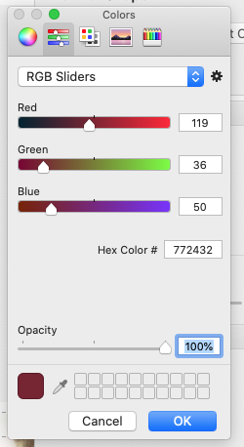
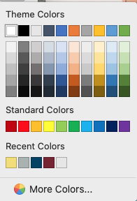
Toastmaster brand colors
RBG= Red, Green Blue for Digital Use
True Maroon
R= 119
G=36
B=50
How can change the colors to match brand?
In PowerPoint, Create a shape, select format shape or right click, format, select more colors
Or enter the RGB for the color you want to use
Loyal Blue
R= 0
G=65
B=101
R= 169
G=178
B=177
Cool Gray
R= 242
G=223
B=116
Happy Yellow
* Happy yellow is for accent color only

Slide 3
Fonts
Usage: Headlines and subheads
FREE ALTERNATE: Montserrat
https://fonts.google.com/specimen/Montserrat#standard-styles
Gotham is Toastmasters International’s primary typeface. The wide stance and geometric traits of its characters exude confidence without looking stiff or digitalized.

Slide 4
Body Copy
Myriad Pro is Toastmasters International’s typeface for body copy in collateral, such as manuals and brochures. This typeface was selected for its legibility when used in large amounts of copy at a small point size.
The Myriad Pro typeface is also available in Condensed, SemiCondensed, and SemiExtended formats.
Usage: Body copy for collateral
FREE ALTERNATE: Source Sans Pro
■ Source Sans Pro is similar in appearance to Myriad Pro and can be used for free.
■ Use this link to access the free

Slide 5
How to Install Fonts
Mac
On the Start menu, click Control Panel . In Control Panel, double-click Fonts. On the File menu, click Install New Font. Locate the downloaded or unzipped font, and then in the List of Fonts box, click the font that you want to add.
Enter Gotham Font in your search engine, example: https://freefontsfamily.com/gotham-font-family/
Downlaod the font
PC
On the Start menu, click Control Panel . In Control Panel, double-click Fonts. On the File menu, click Install New Font. Locate the downloaded or unzipped font, and then in the List of Fonts box, click the font that you want to add.

Slide 6
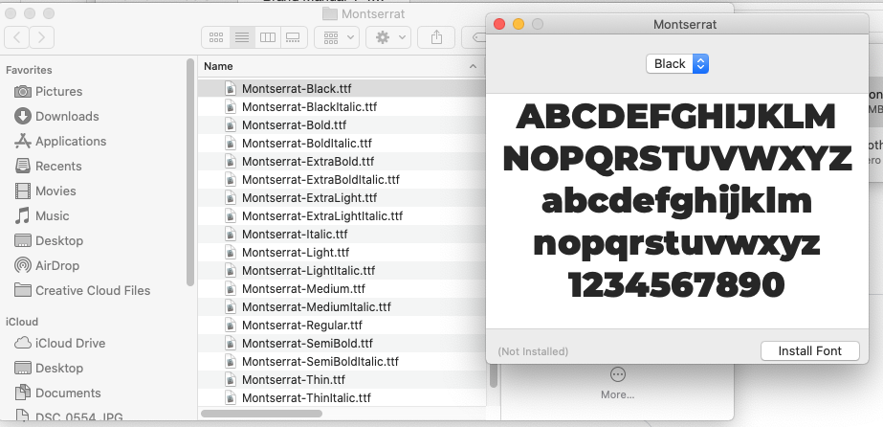

Slide 7
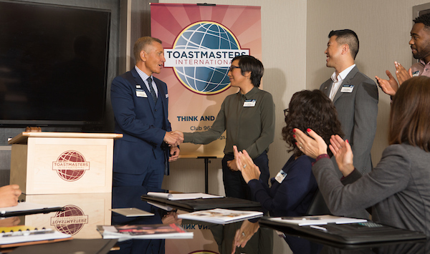
Speaker to Trainer
December 4, 2021
Area Speech Contest
How to use:
Duplicate this slide.
Edit and ad your own info.
Group all, ( select and group) right click group
Save a jpeg.
{Date- Register now}
Time, other info
Resister today!

Slide 8
International Speech contest
Speaker to Trainer
December 4, 2021
How to use:
Duplicate this slide.
Edit and ad your own info.
Group all, ( select and group) right click group
Save a jpeg.
{Division Info }
Photo of host
Time
Date
Info
Hosted by
Register today!

